Slide 1
Testing points
Final Testing steps for project
Test your domain URL should get page from 2 Different IP ( servers)
Now terminate 1 instance and check URL only coming from 1 IP (ec2 instance)
After 5 min check if auto scaling has launched a new instance
Again Test your domain URL, it should get output from 2 Different IPs (ec2 instances)
Increase CPU utilization on one instance and then check if 3rd instance has been launched by ASG

Slide 2
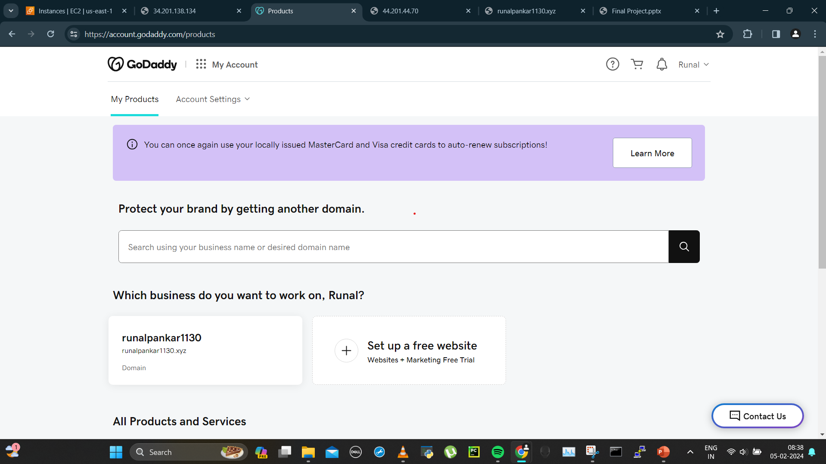
My domain

Slide 3
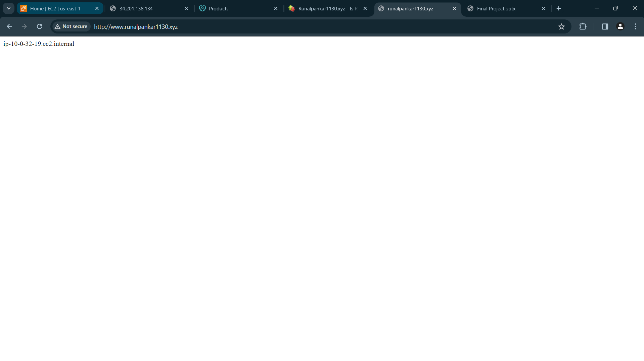
Test 1:Testing my domain url giving 2 different ips
1 IP-

Slide 4
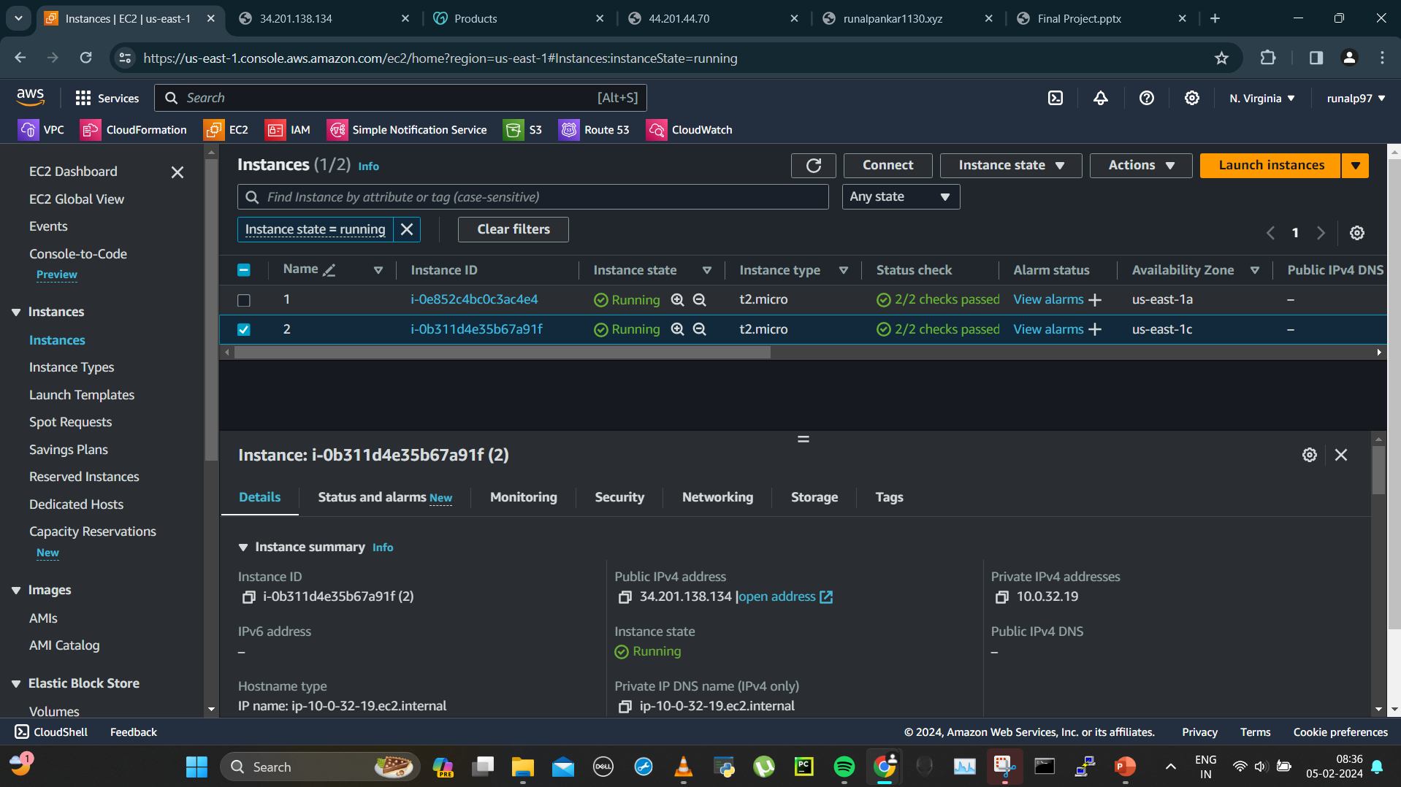
2 instances

Slide 5
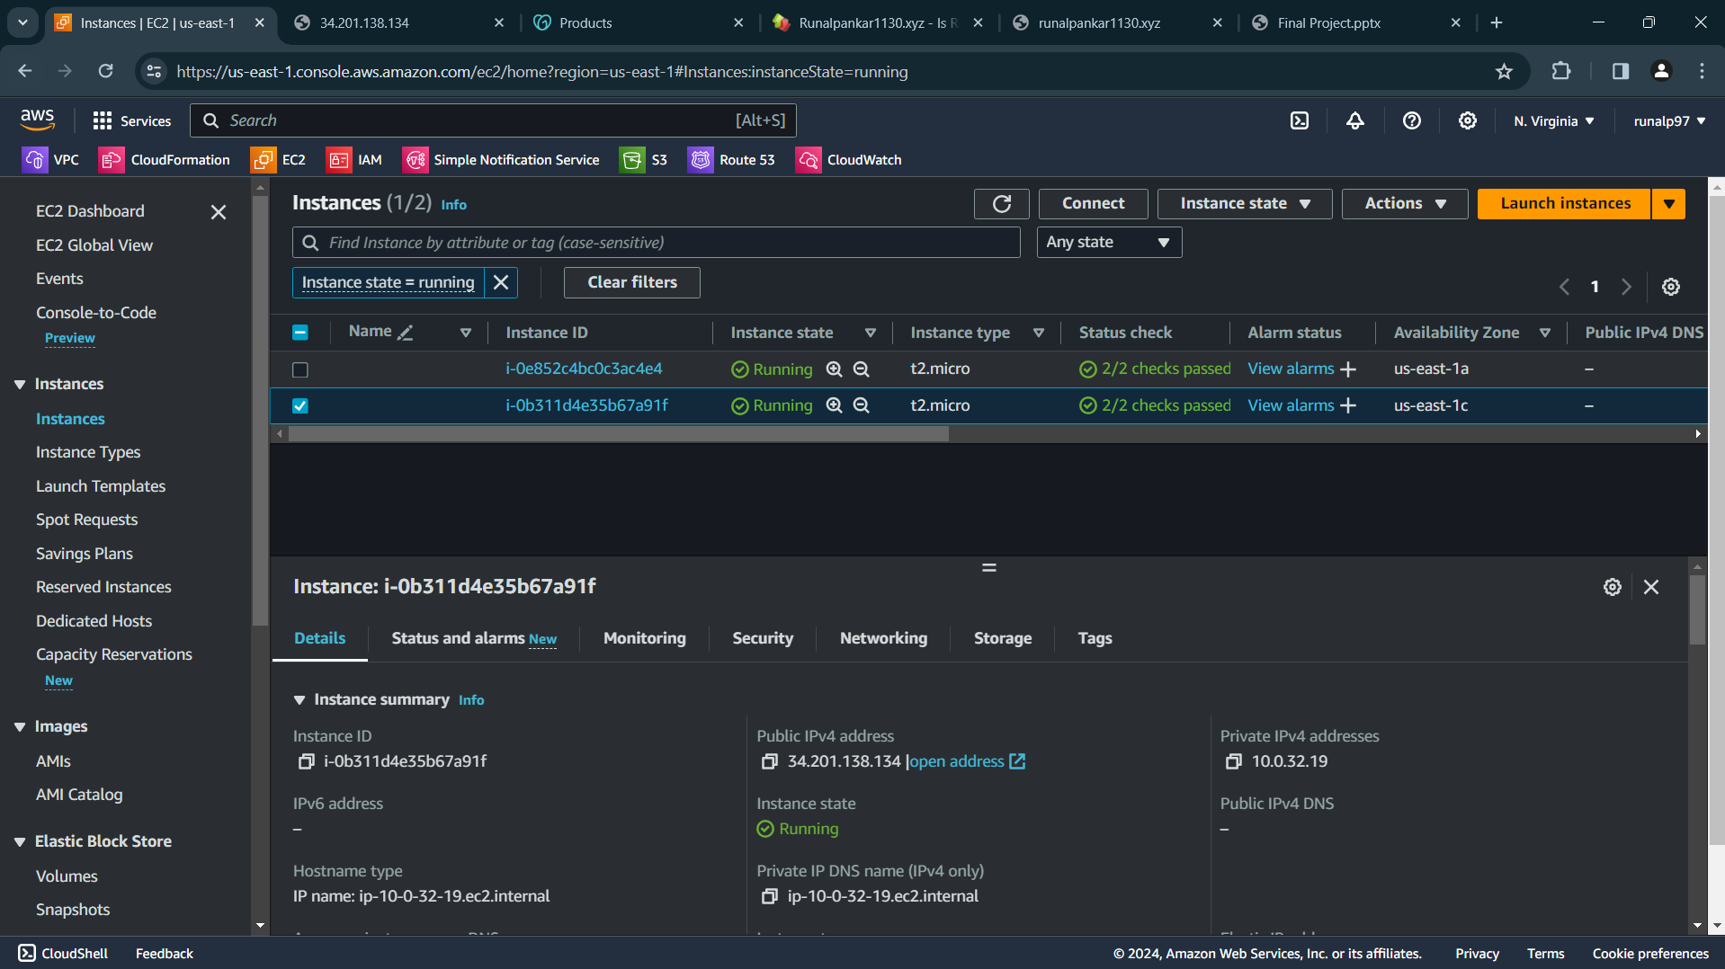
First ip

Slide 6
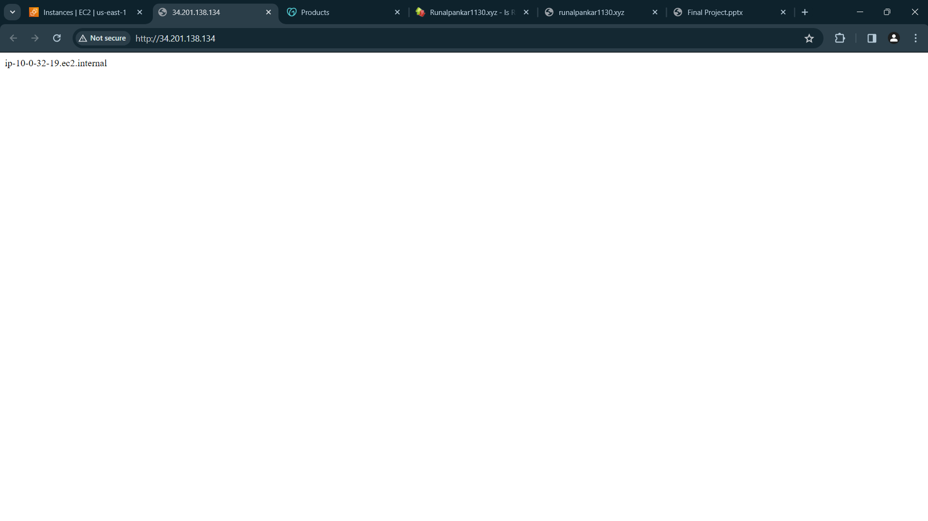
1st ip

Slide 7
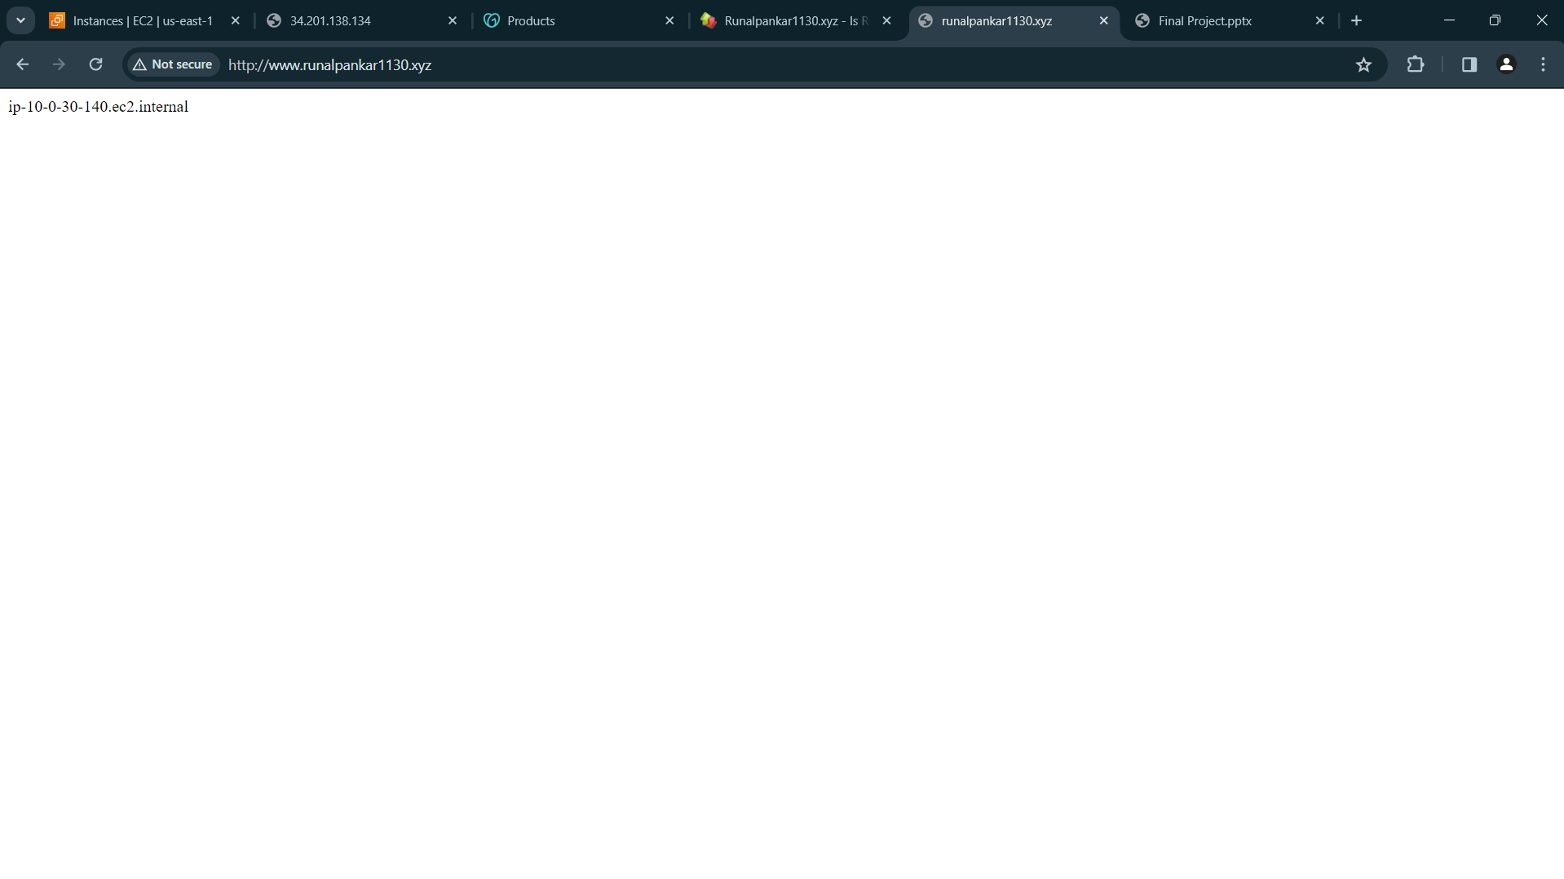
2nd ip

Slide 8
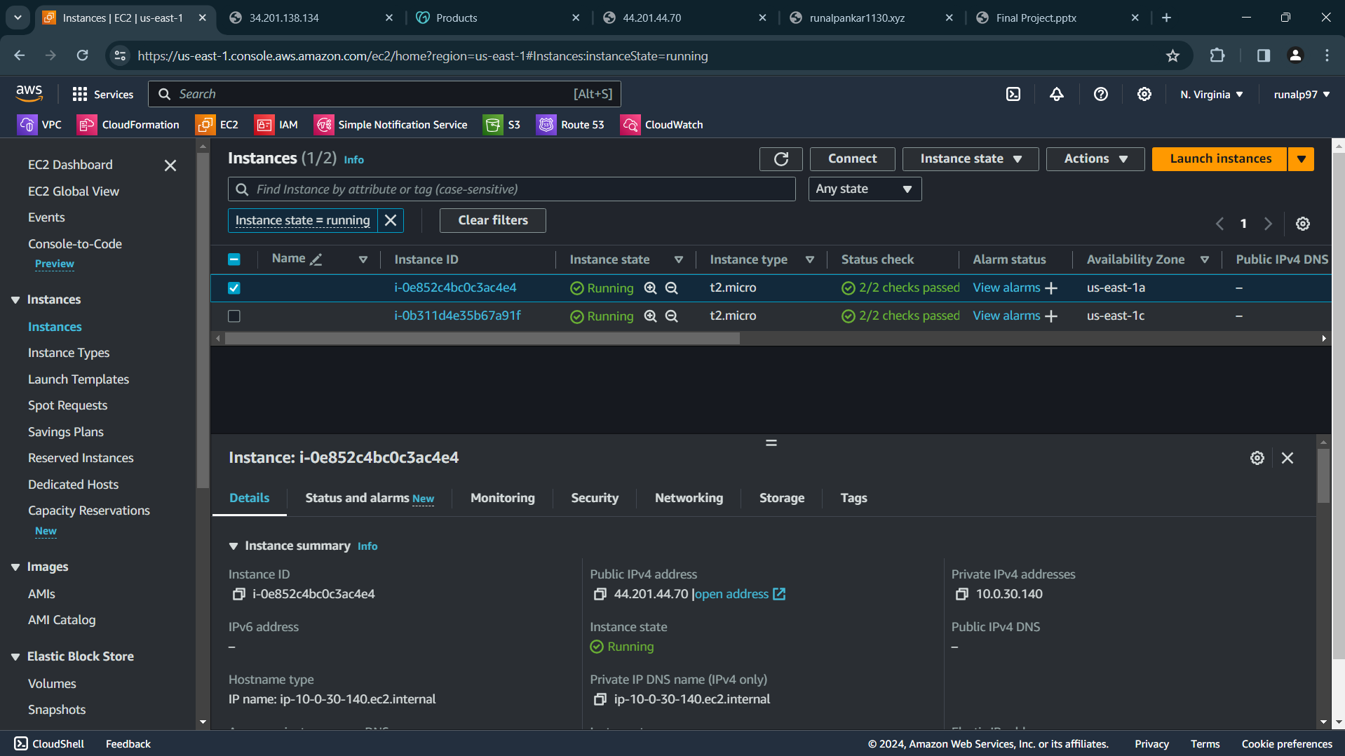
2nd ip instance

Slide 9
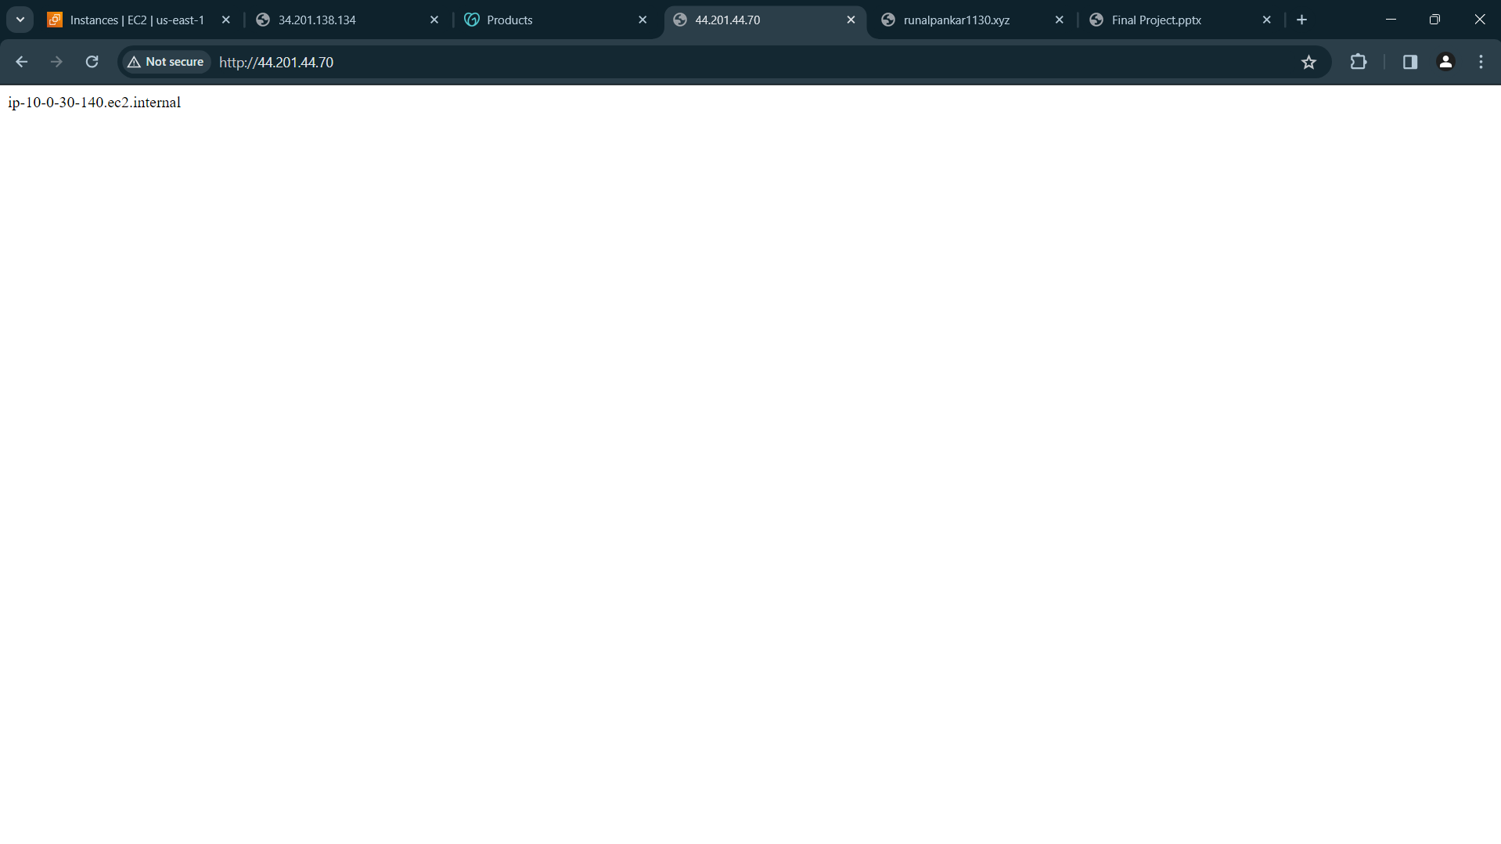
2nd ip instance public ip

Slide 10
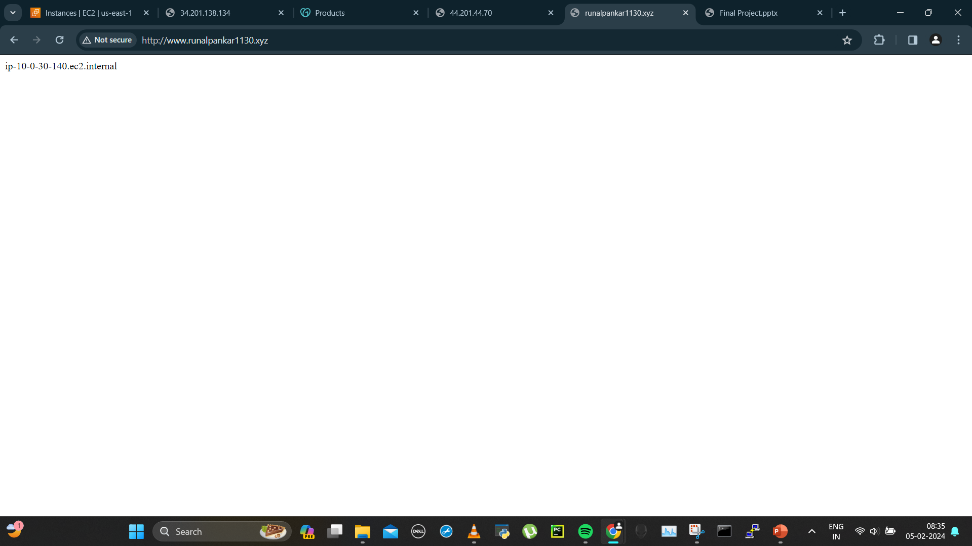
2nd ip on url

Slide 11
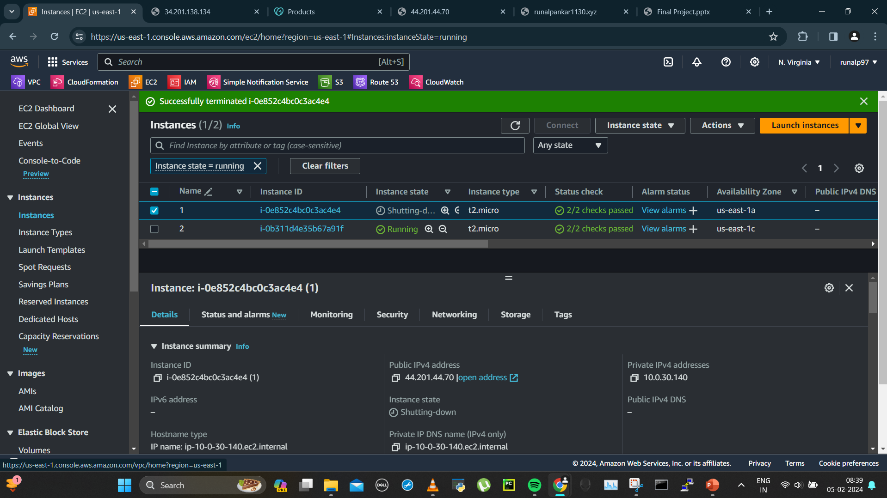
Test2:Now terminating one instance to check url coming from only 1 instance- terminated 1st instance

Slide 12
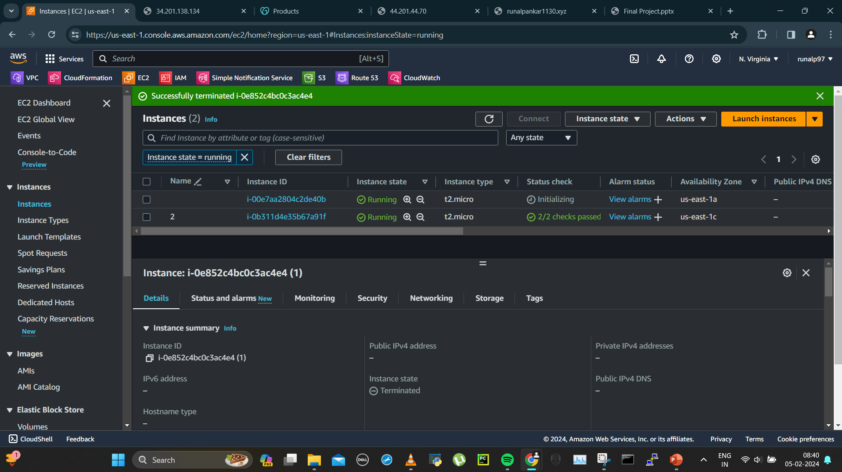
Instance terminated

Slide 13
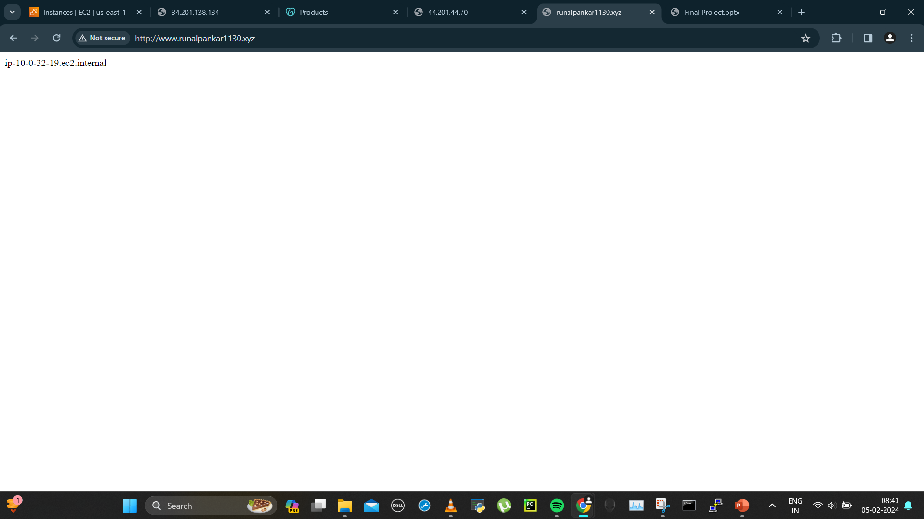
Seeing if url is giving 2 ips, only getting ip of 2nd instance which is not terminated

Slide 14
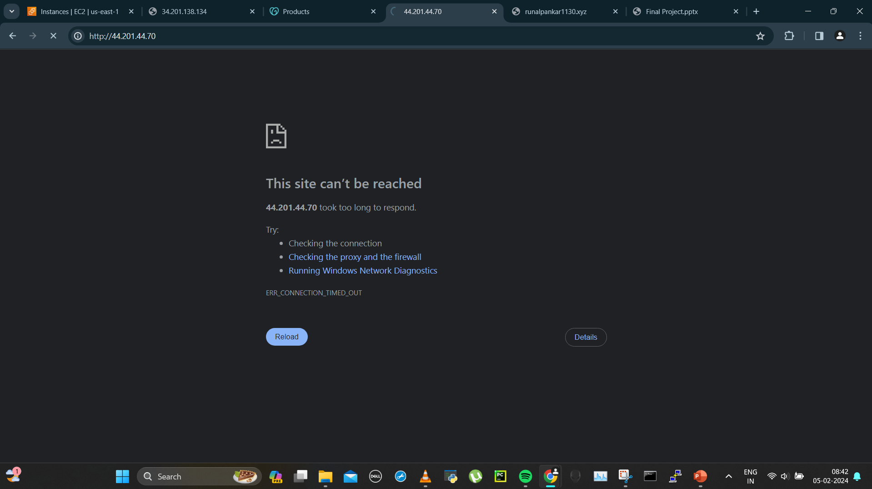
1st instance down

Slide 15

3.Asg made new instance

Slide 16
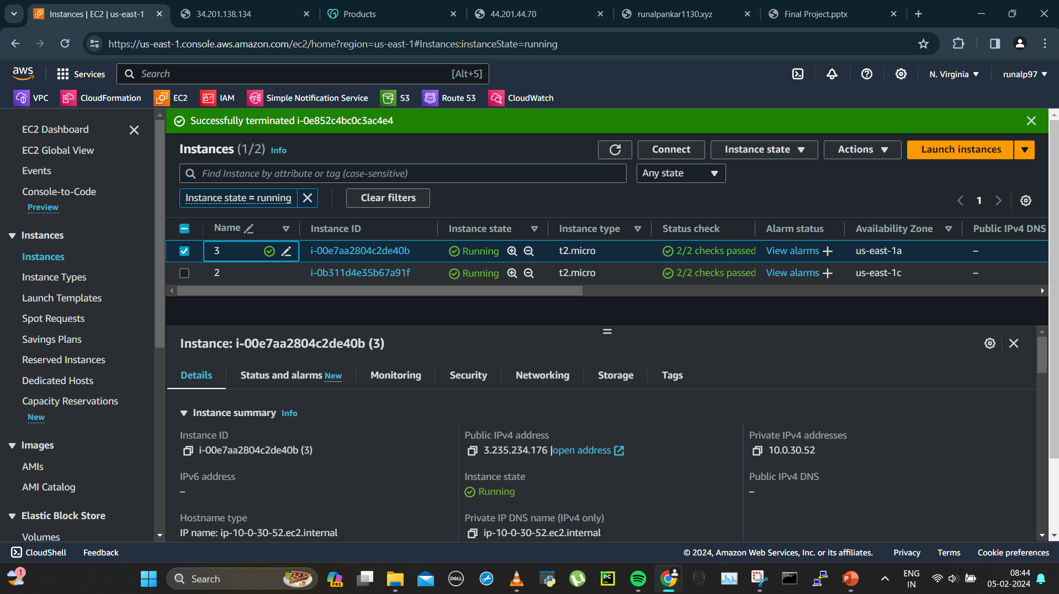
Named it 3rd instance

Slide 17
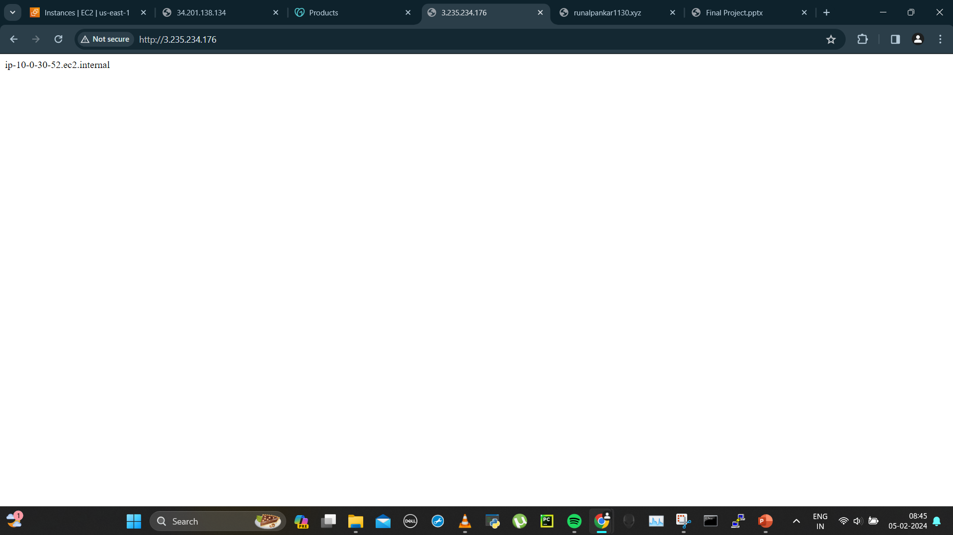
3rd instance ip

Slide 18
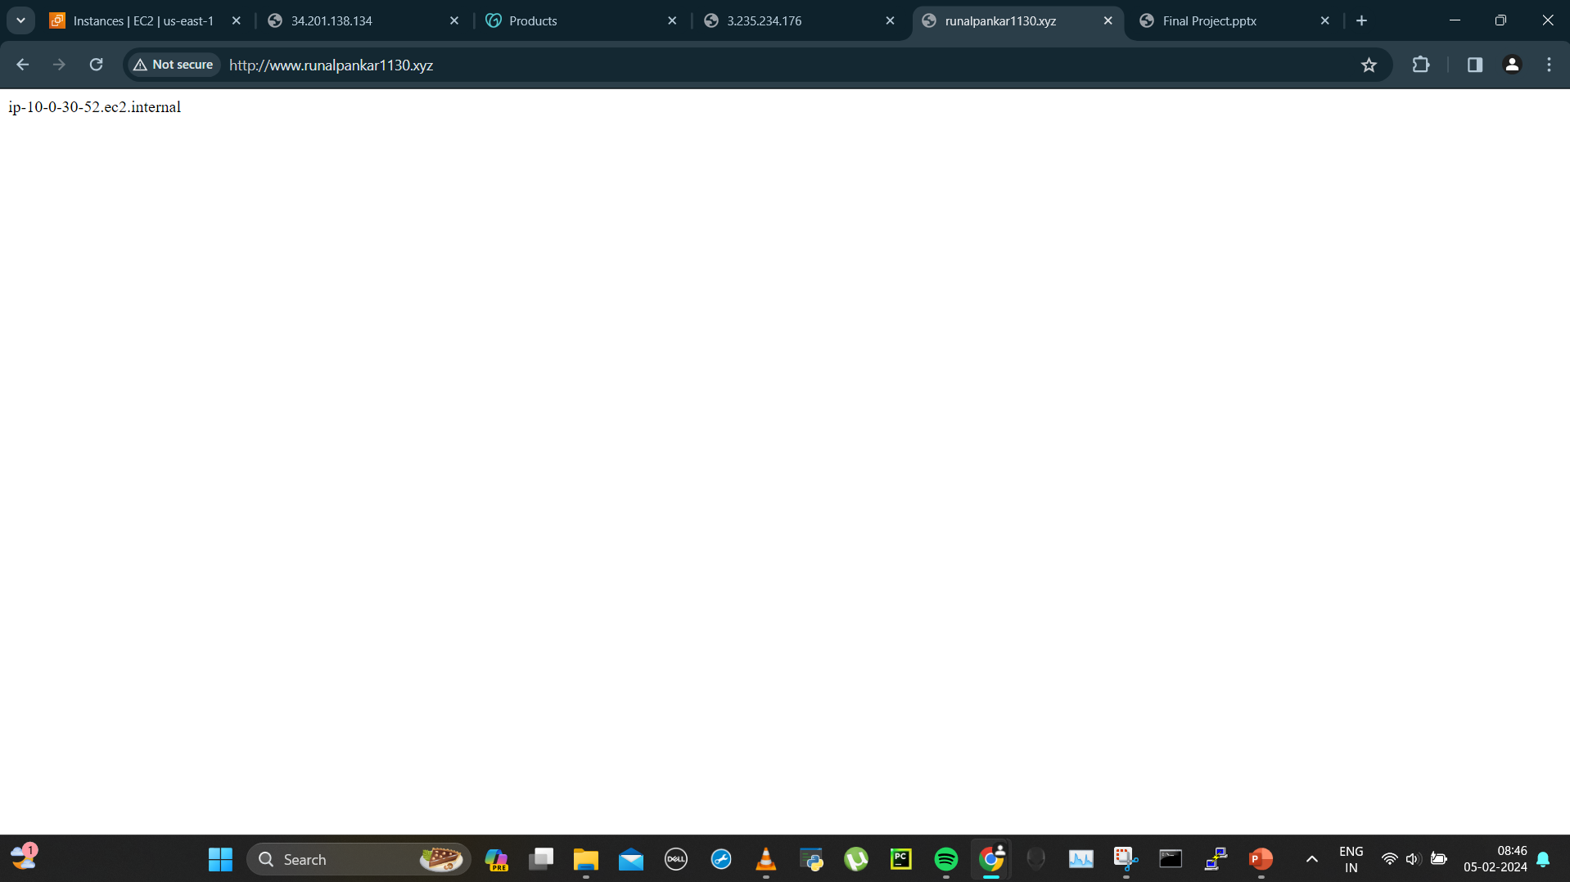
4a)Refreshed my domain and got 3rd instance’s ip

Slide 19
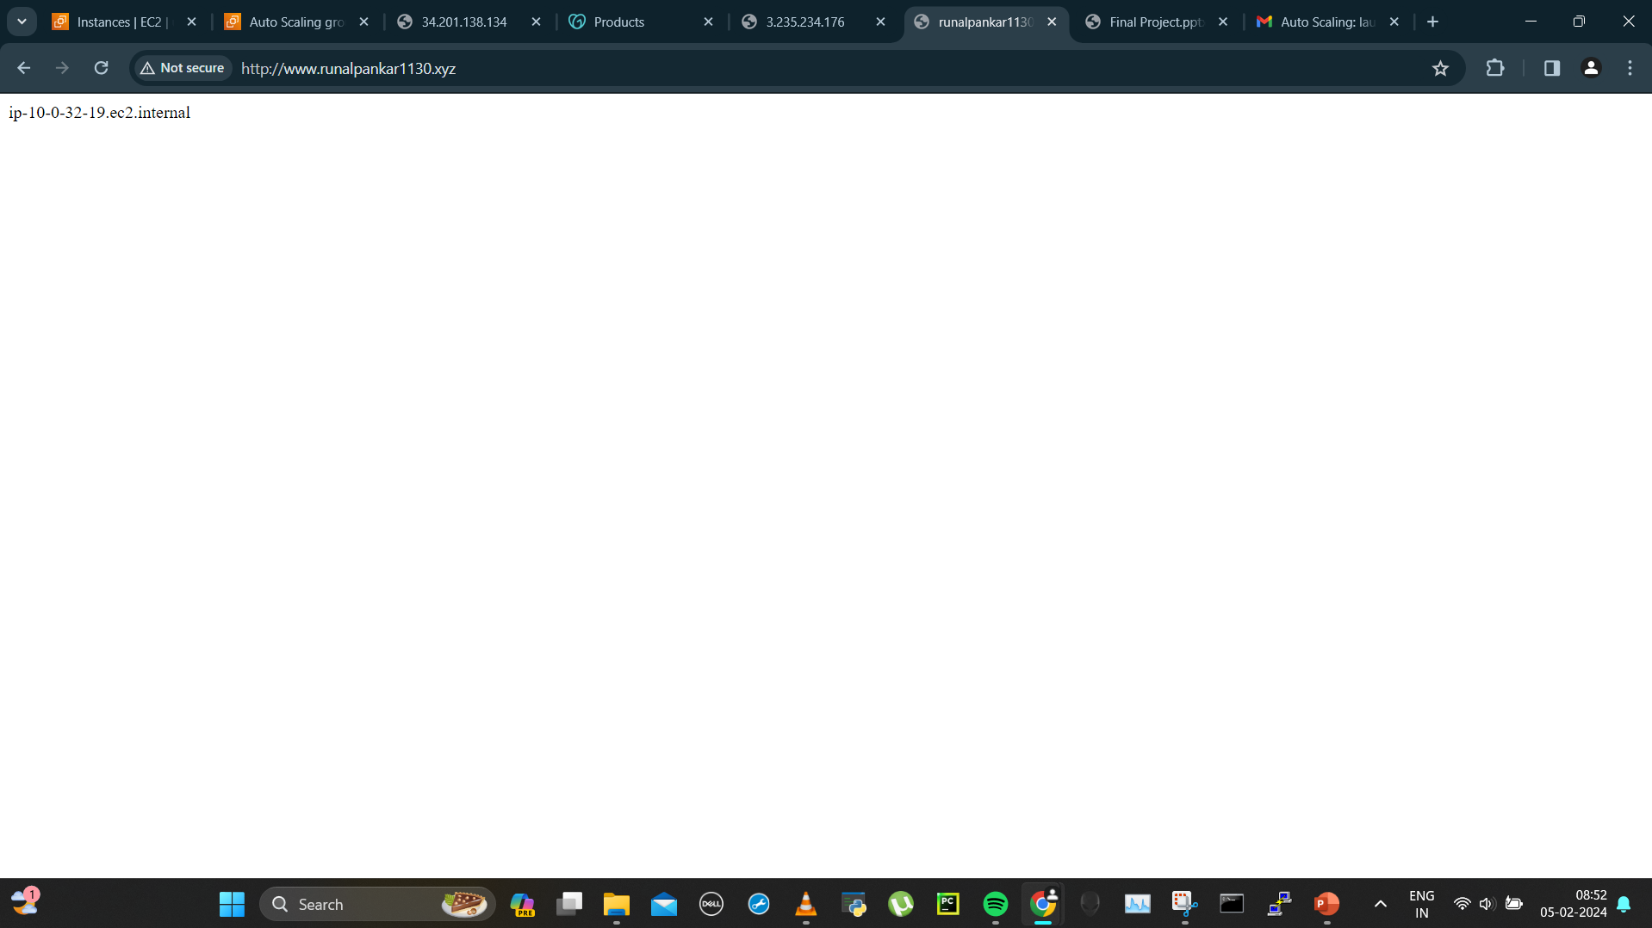
4b)Getting instance 2 ip after terminating instance 1

Slide 20
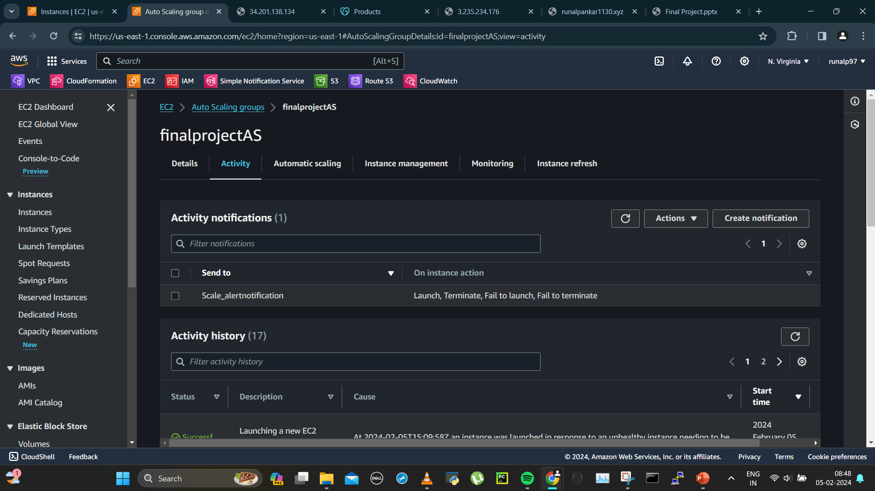
Asg history

Slide 21
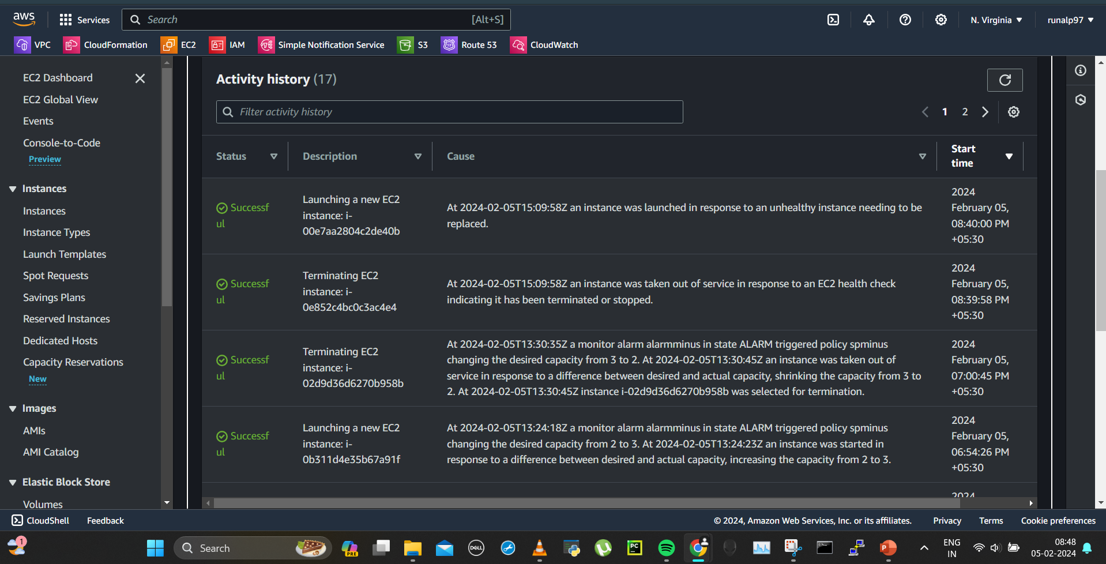

Slide 22
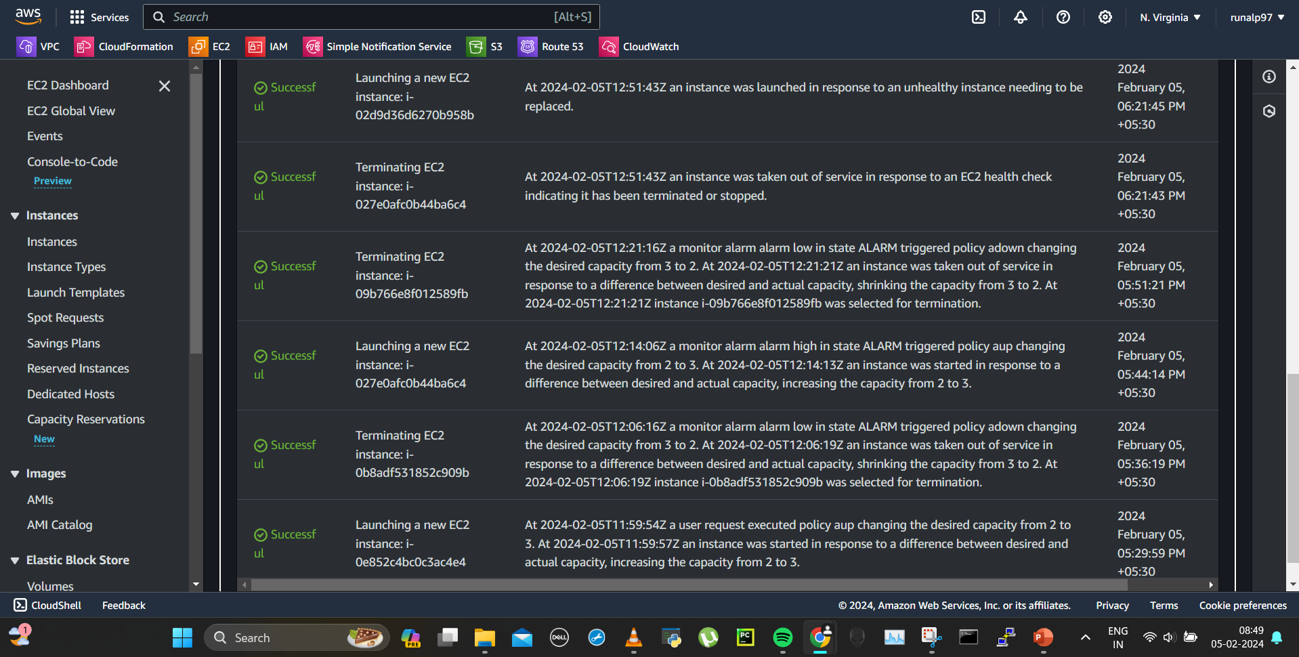
More previous history

Slide 23
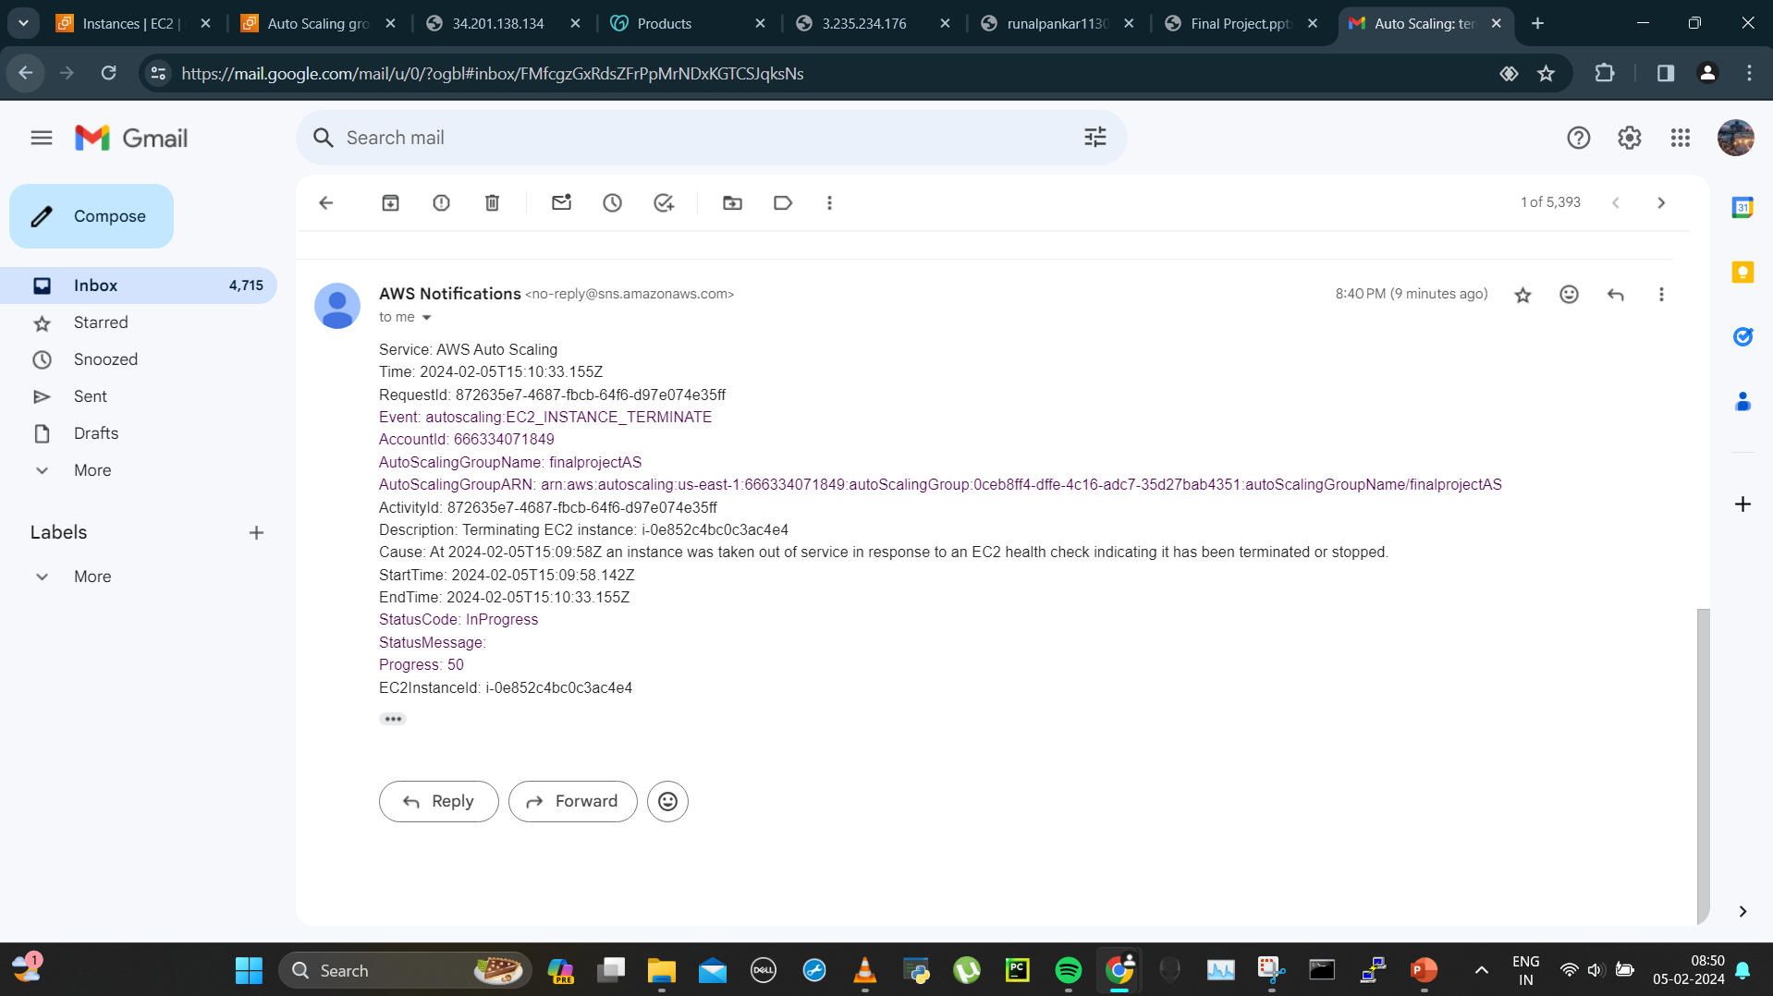
Received a mail regarding terminated instance 1

Slide 24
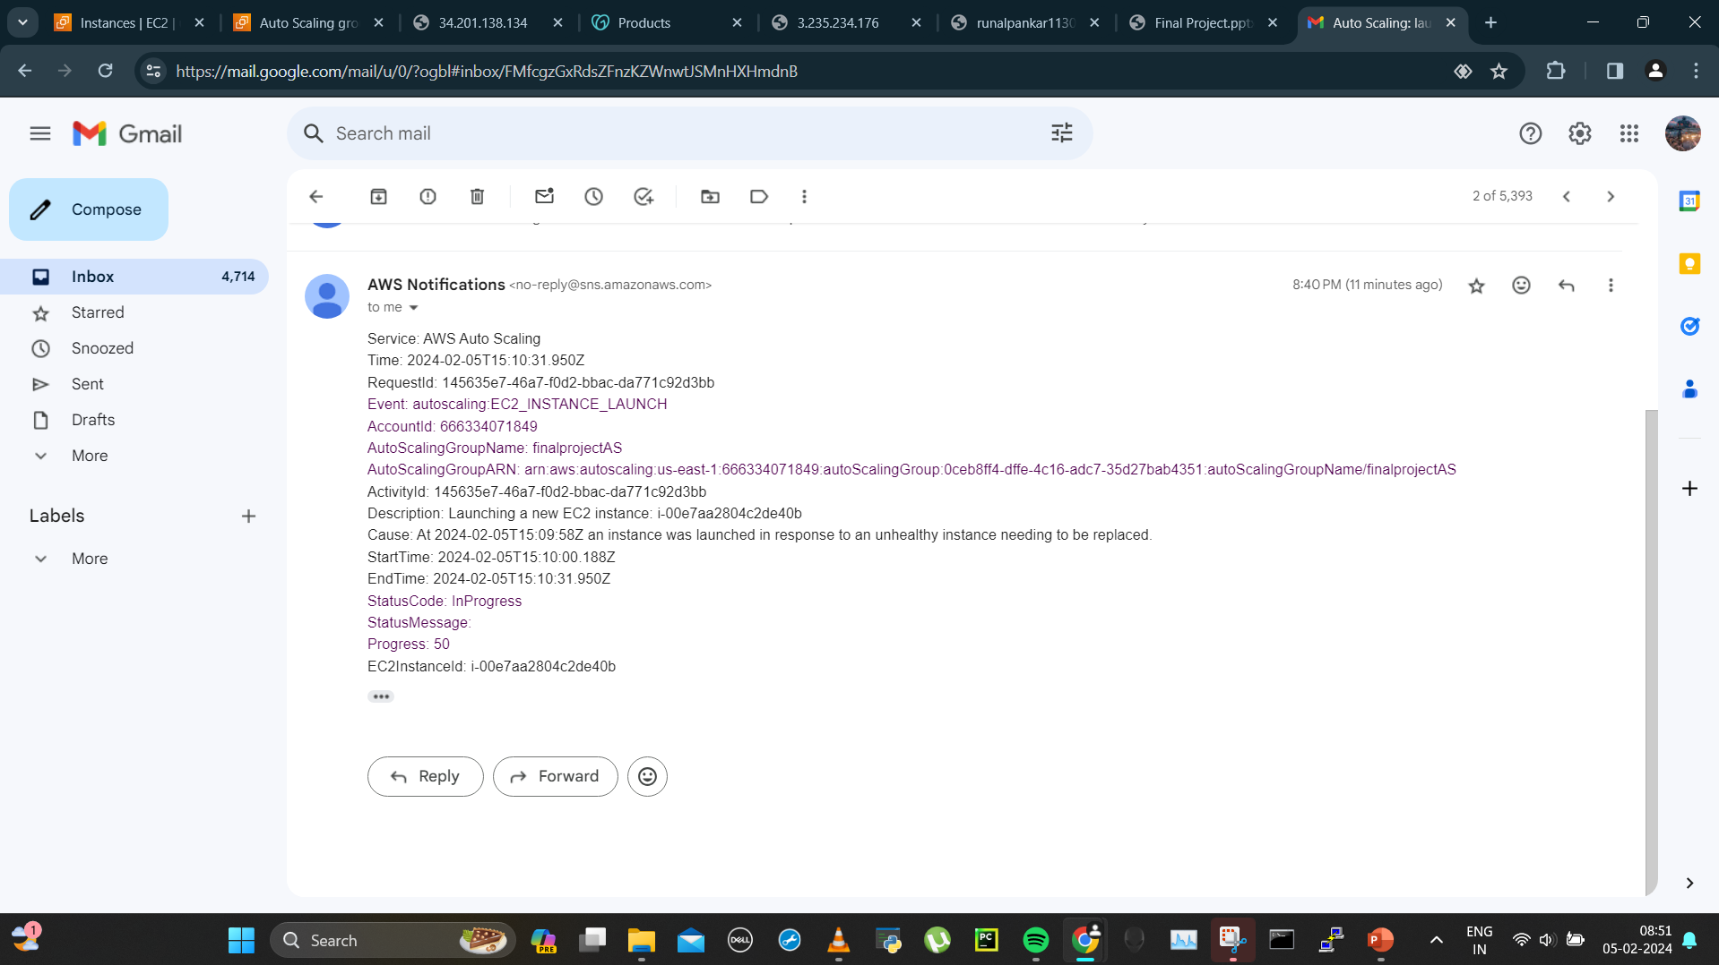
Instance 3rd launch mail recieved

Slide 25
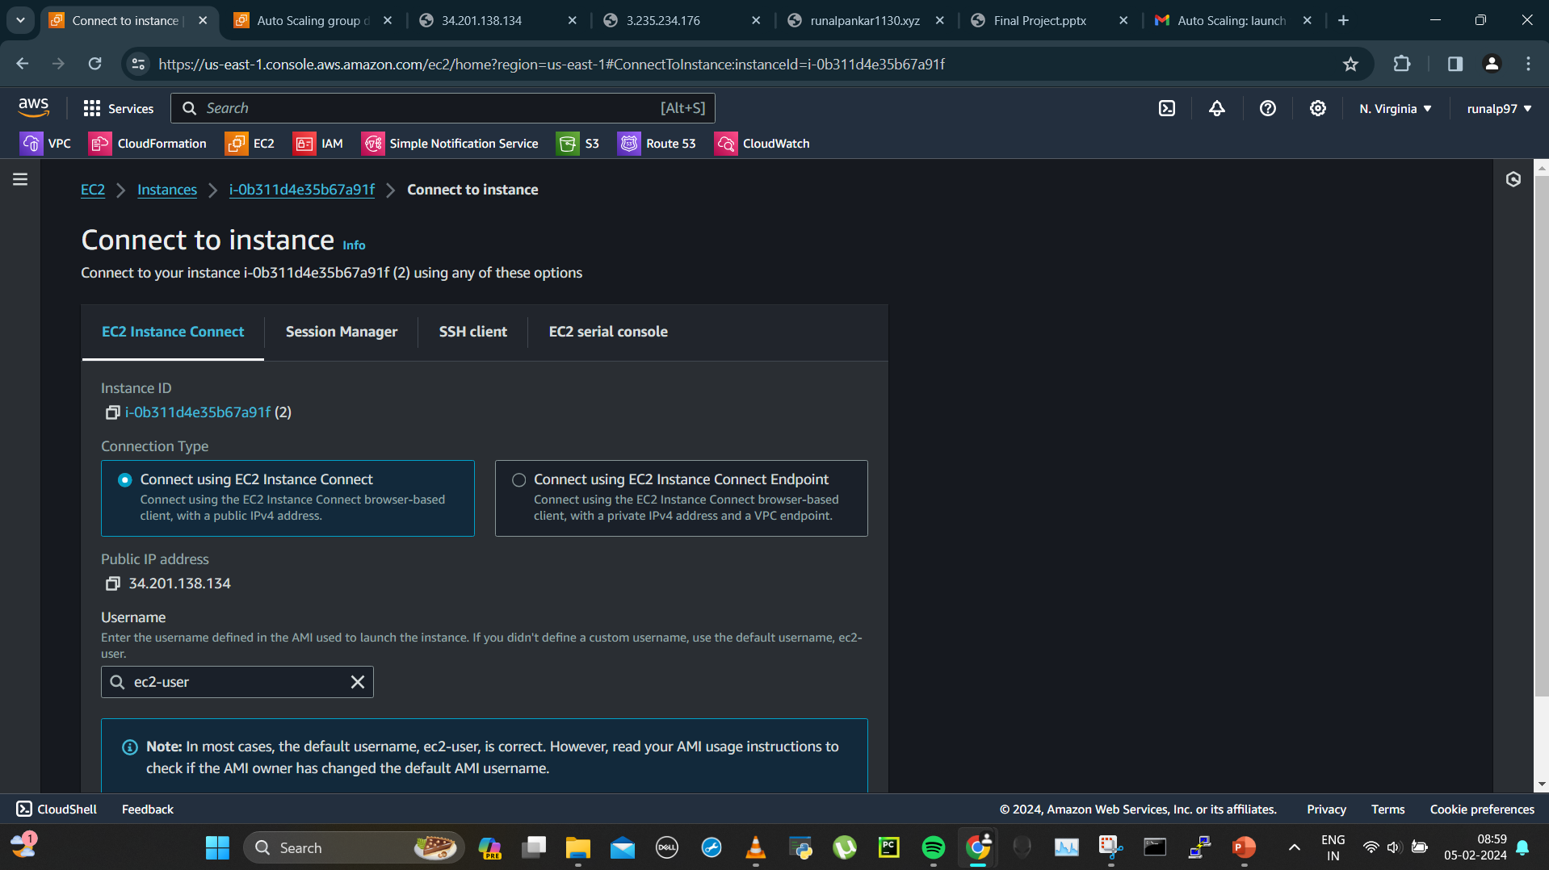
5) Increasing cpu utilization on one of the instance and check if new instance is being created
Increasing load on instance 2nd

Slide 26
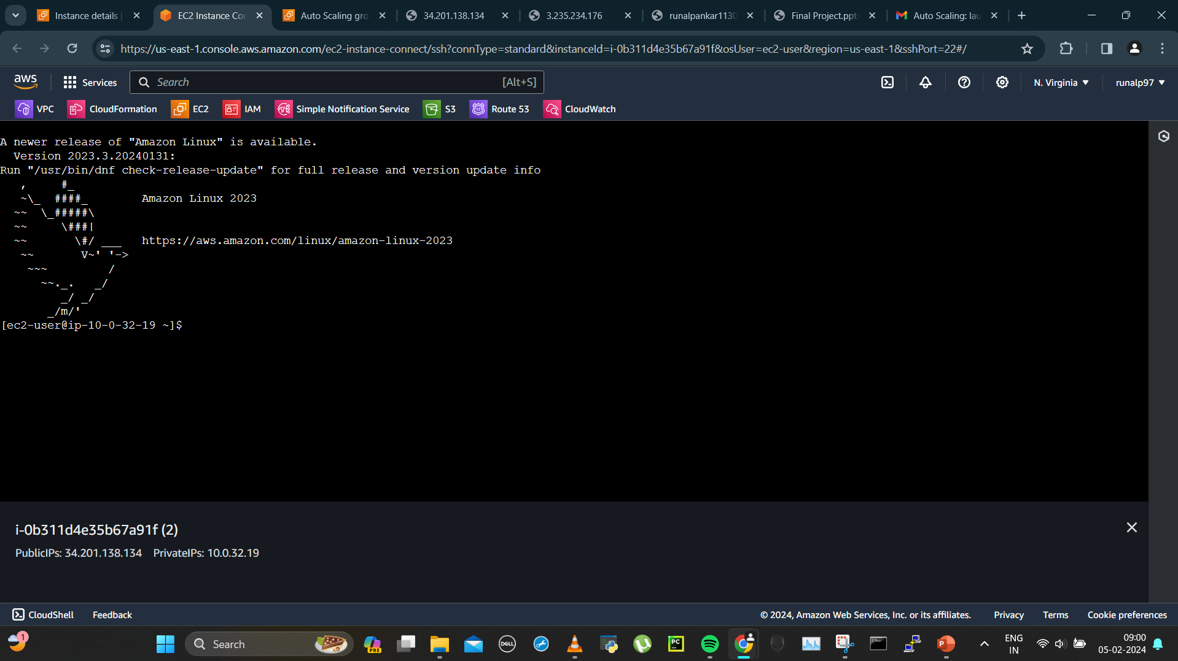
Connected to the instance

Slide 27

Became root and used dd command to increase load which will run in background

Slide 28
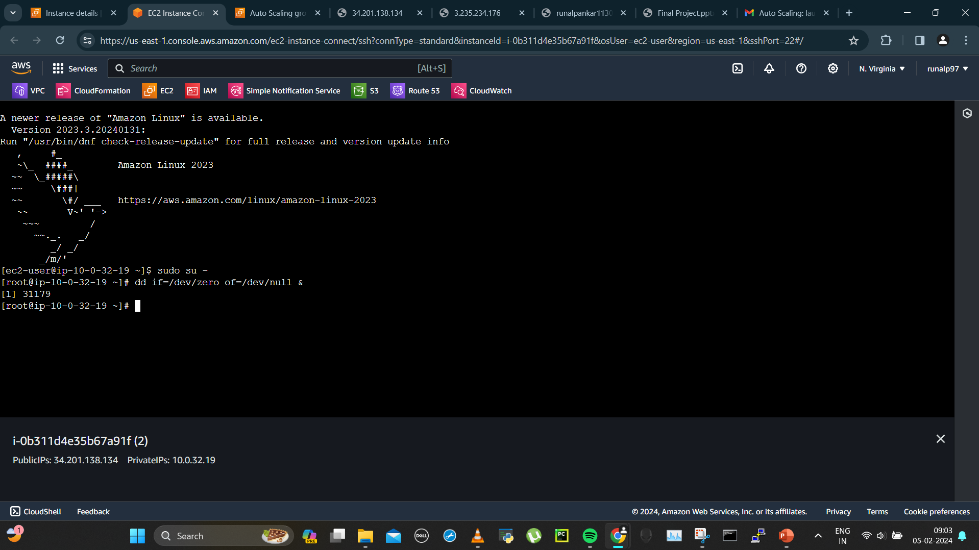
Dd command started

Slide 29
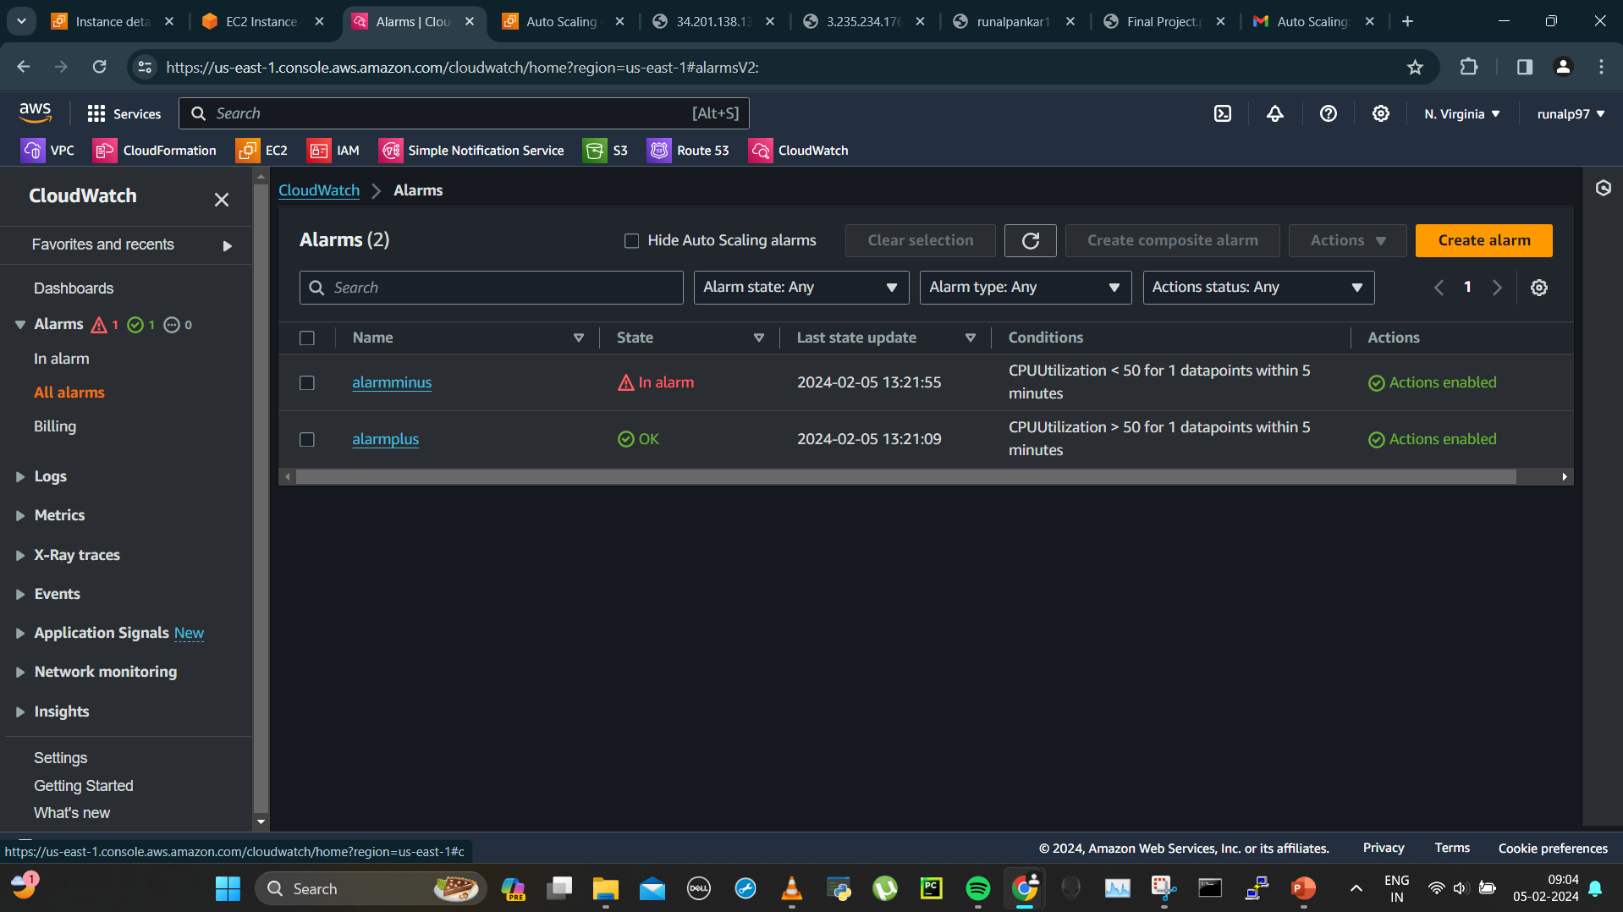
Alarms created for asg

Slide 30
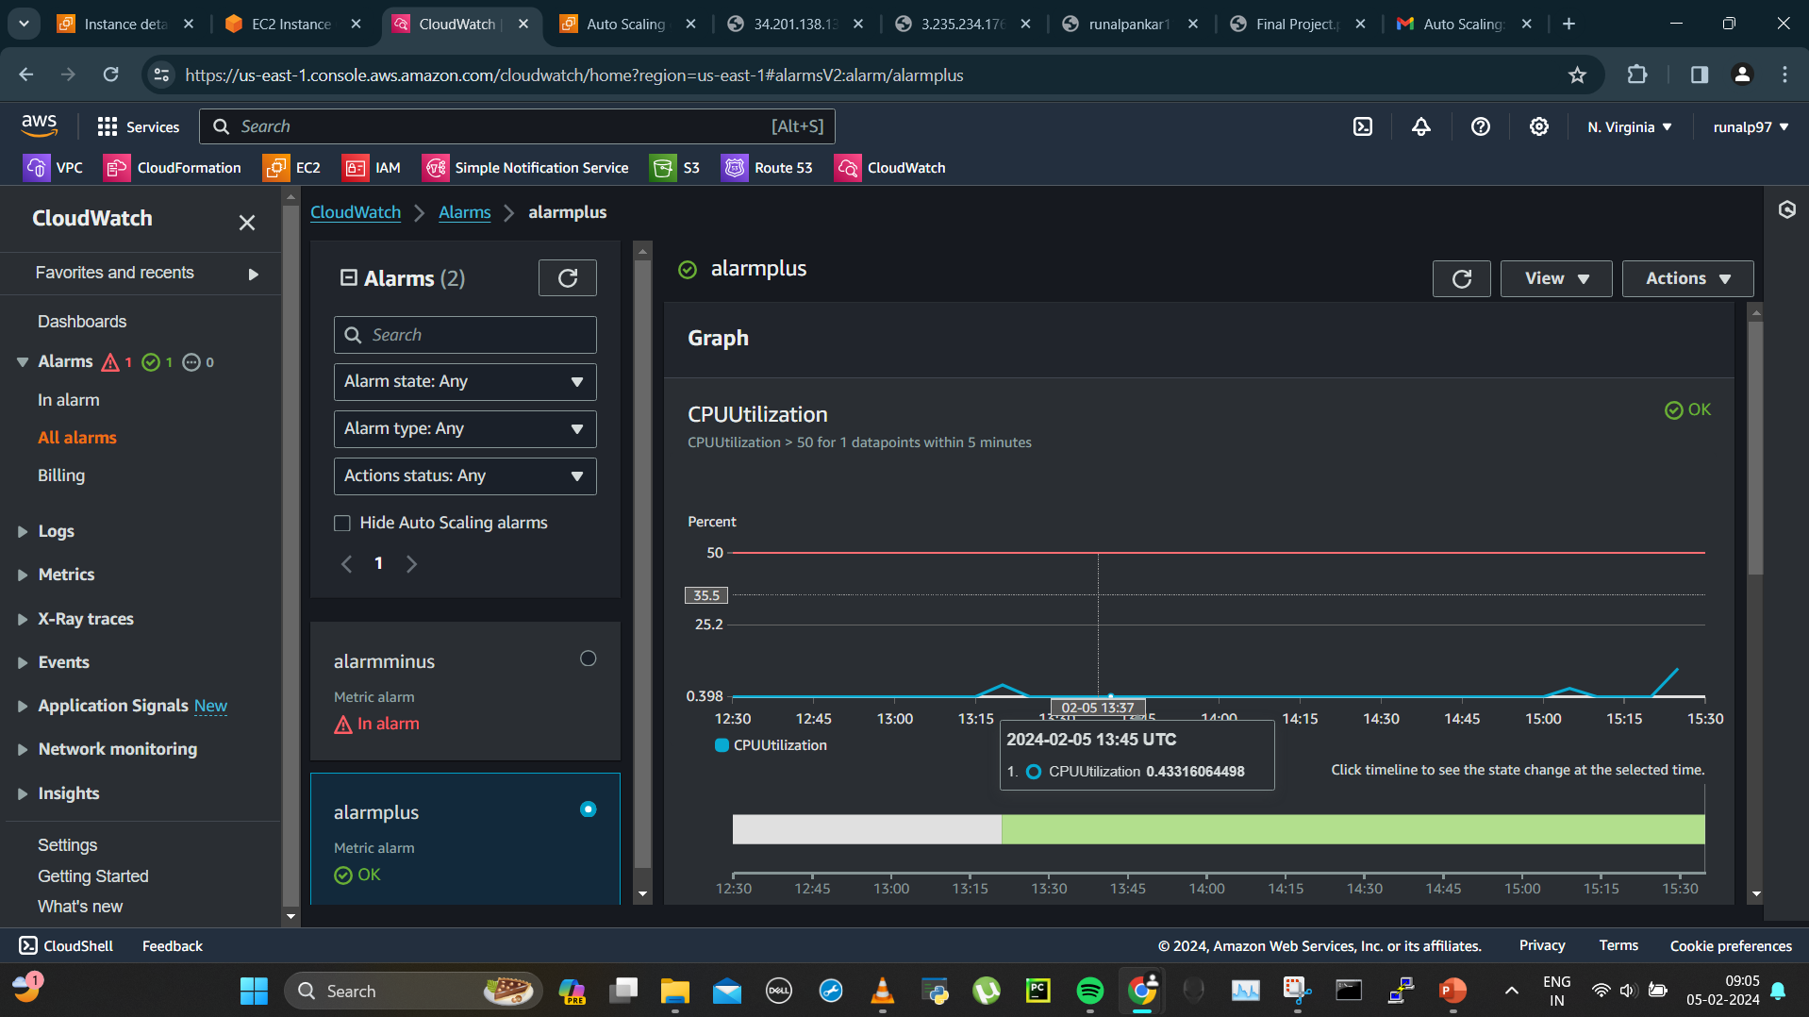
Load increasing on 2nd instance

Slide 31
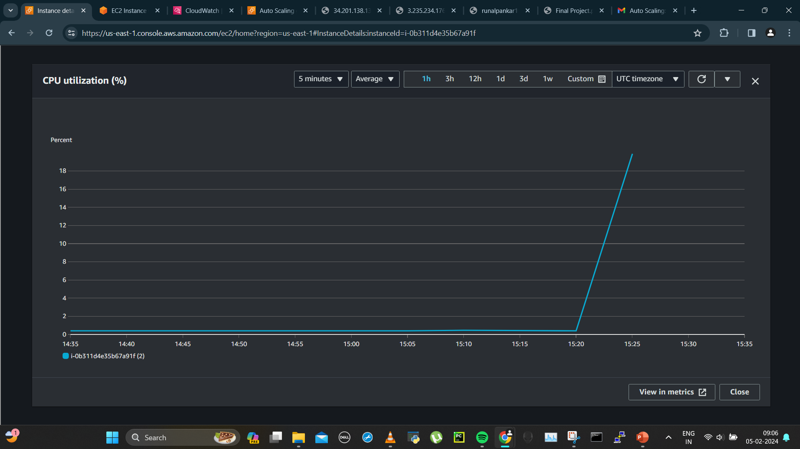
Cpu utilization metric

Slide 32
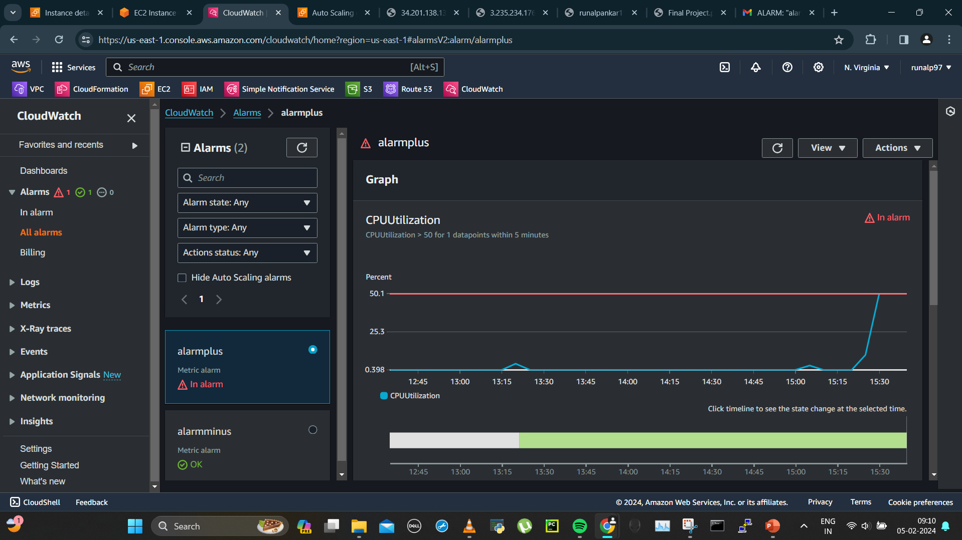
Alarmplus has detected that instance has crossed the threshold of 50%

Slide 33
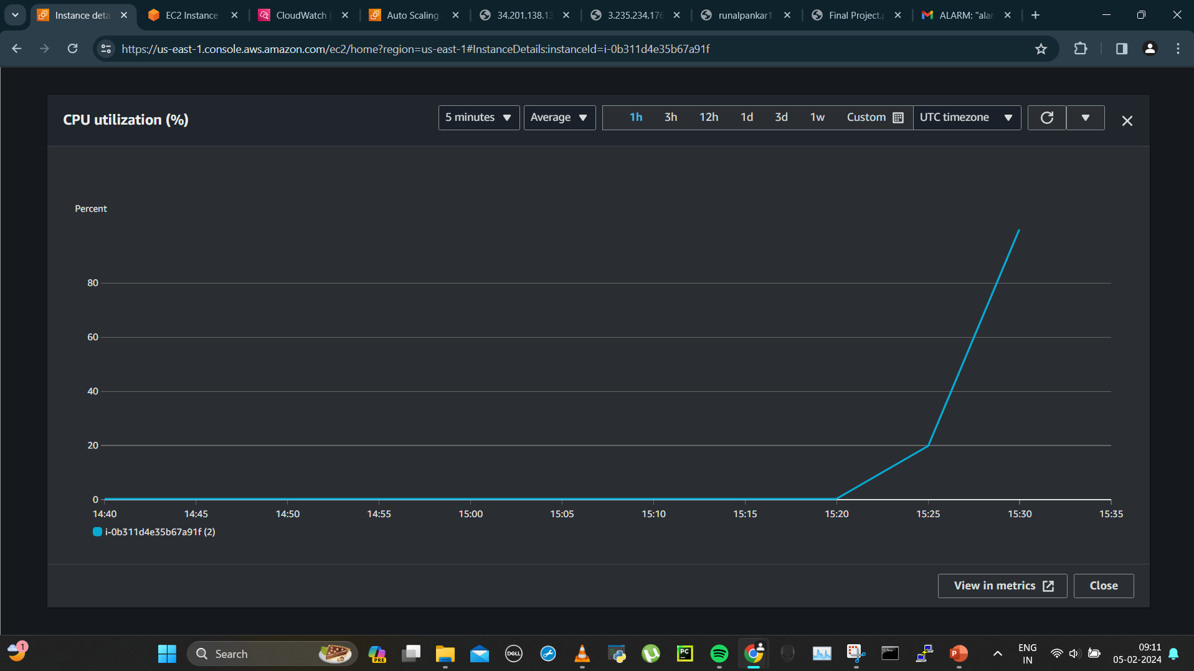
2nd instance metric

Slide 34
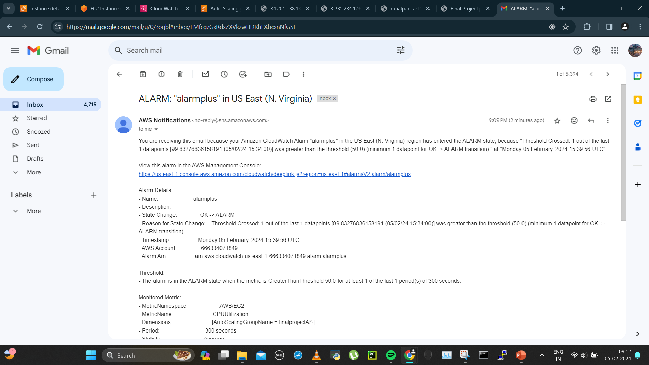
Alarm mail received when cpu utilization gone >50%

Slide 35
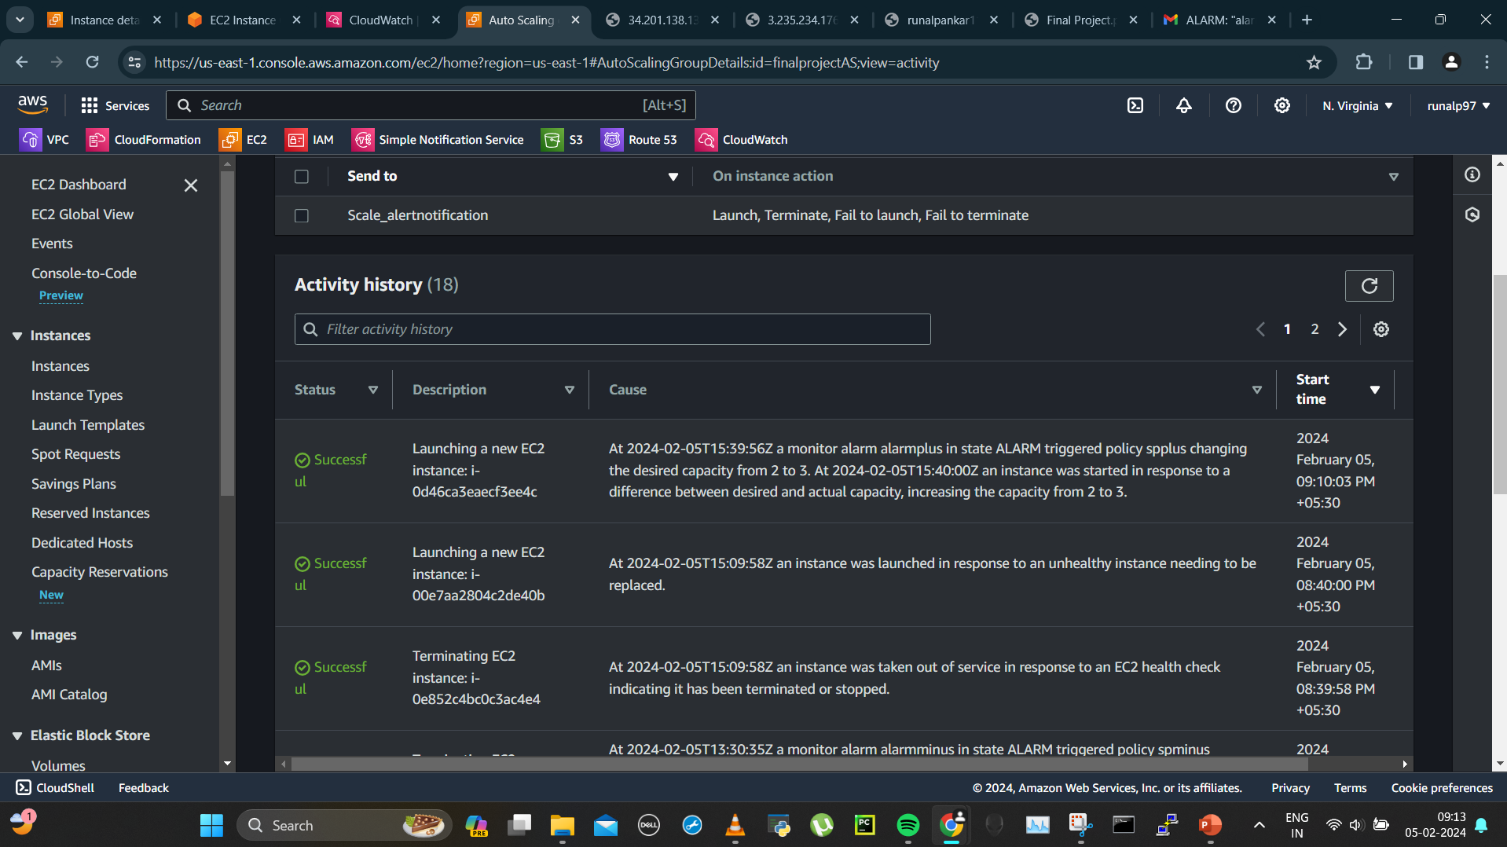
Asg launched new instance

Slide 36
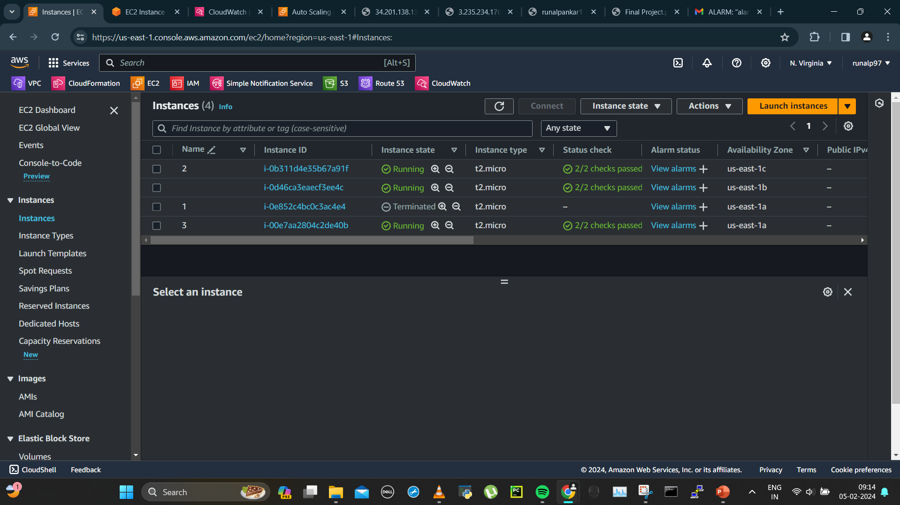
Instance 4th

Slide 37
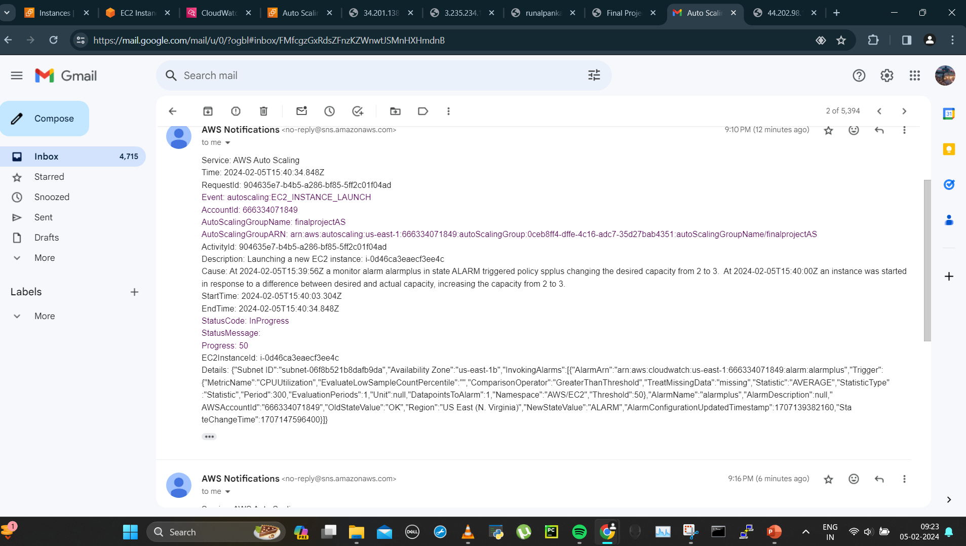
4th instance launched by asg mail recieved

Slide 38
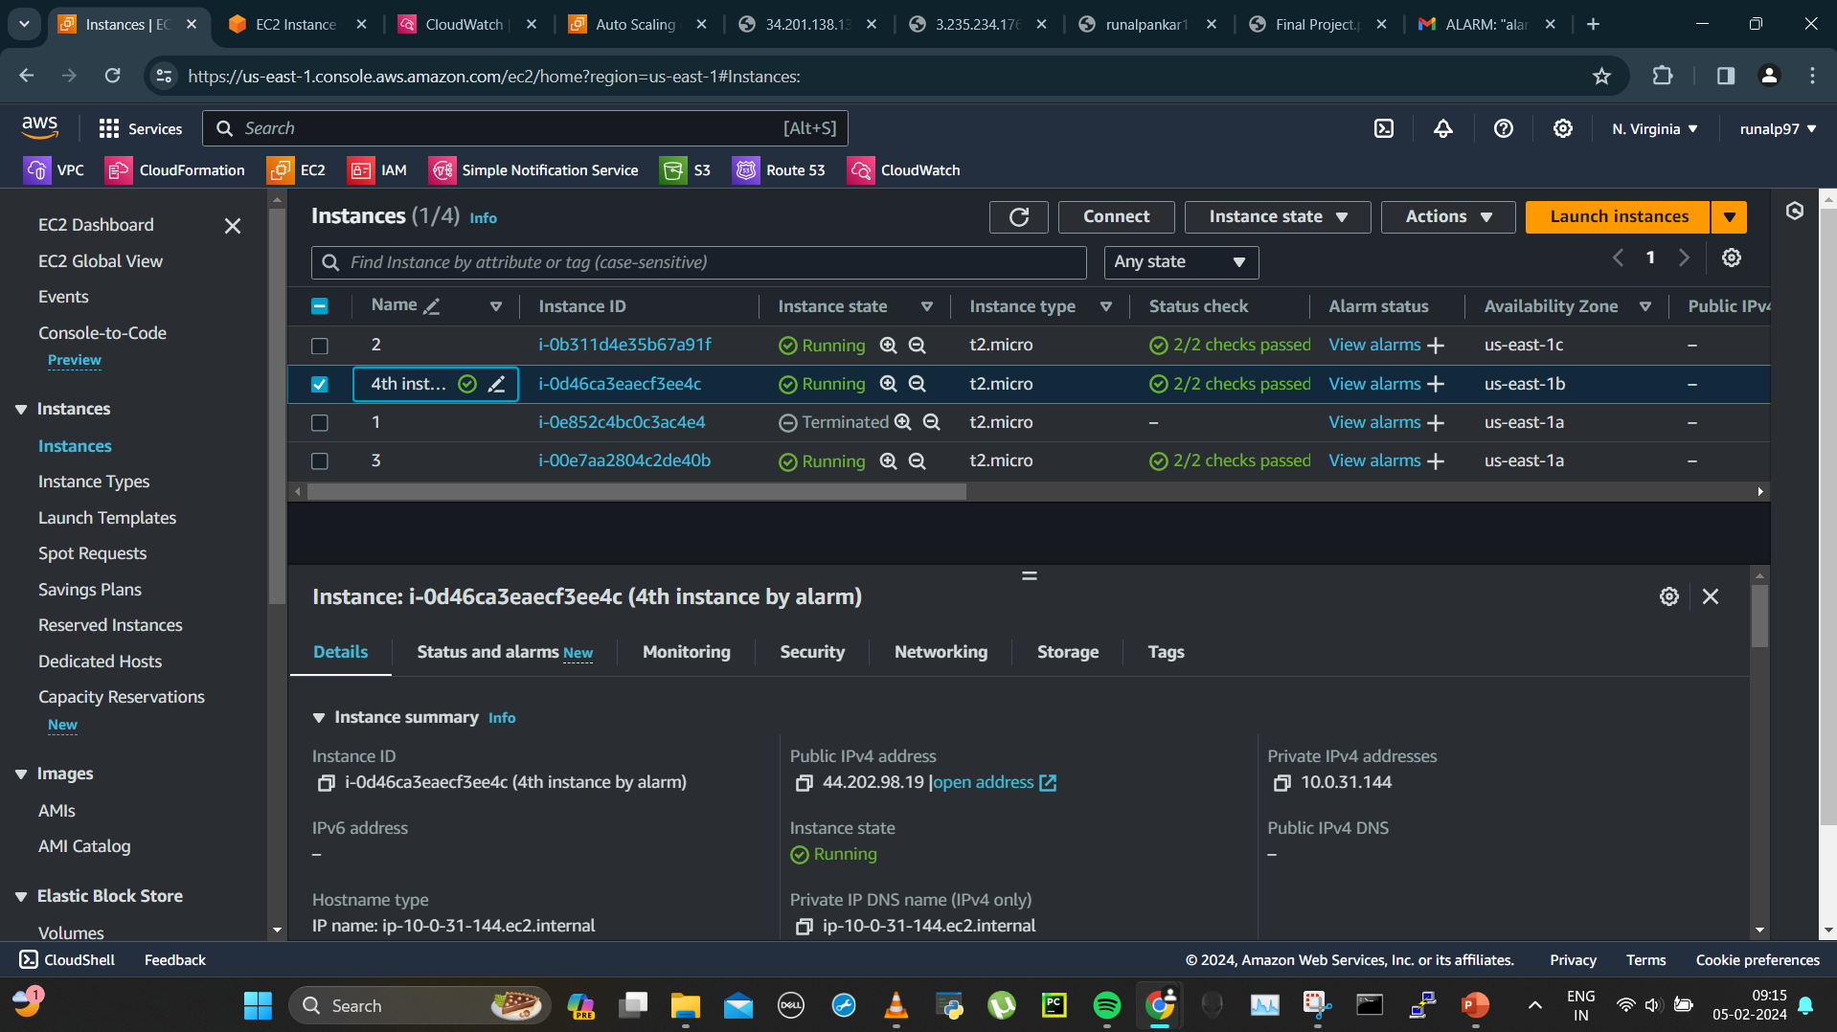
Public ip of 4th instance

Slide 39
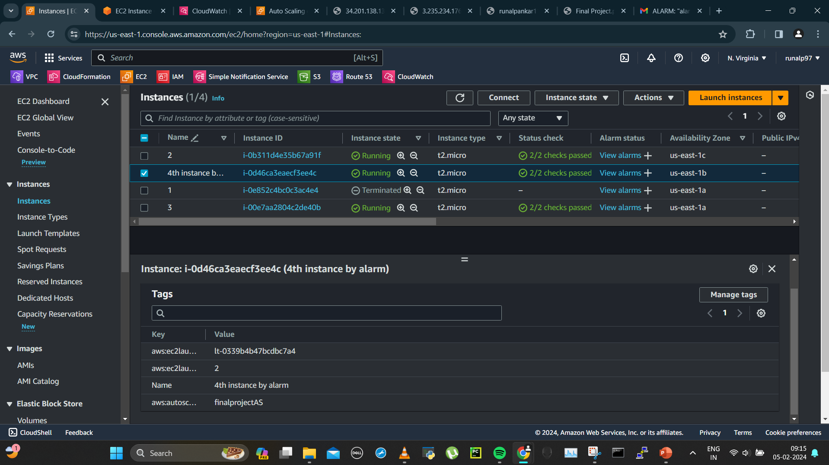
Tag of 4th instance

Slide 40
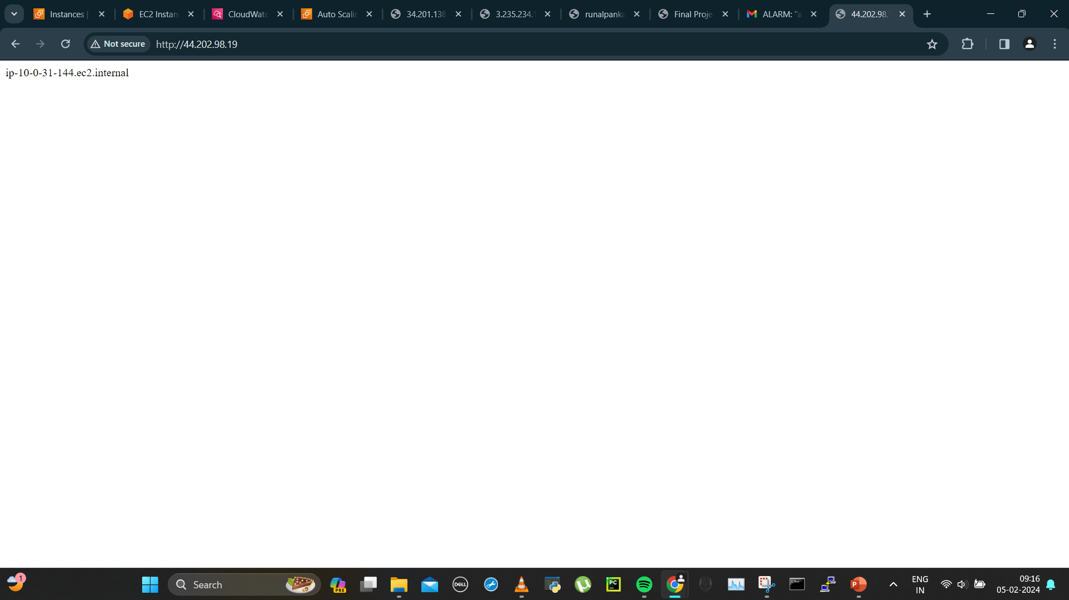
4th instance ip

Slide 41
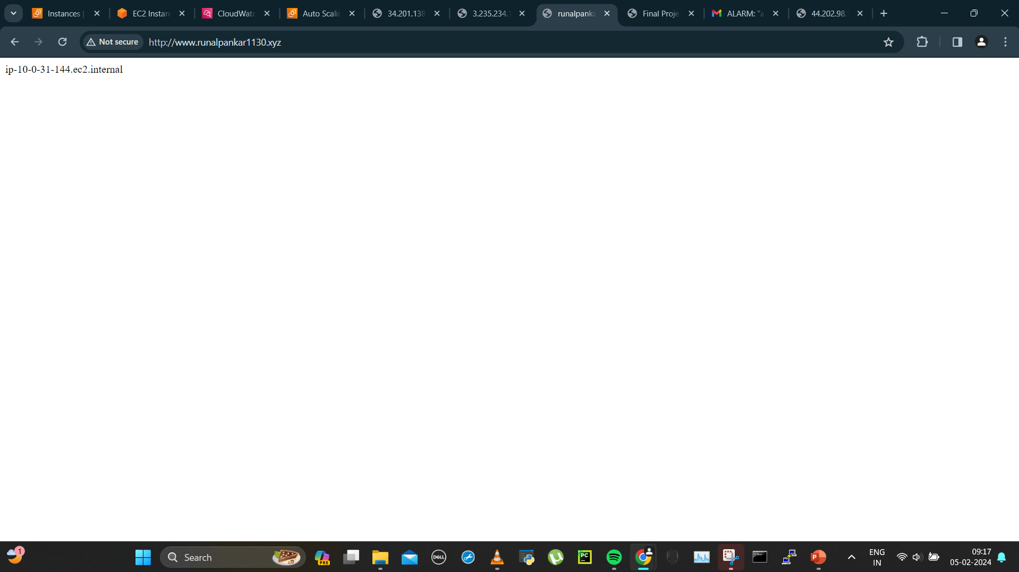
Domain also gave the 4th instance ip now getting all 3ips

Slide 42
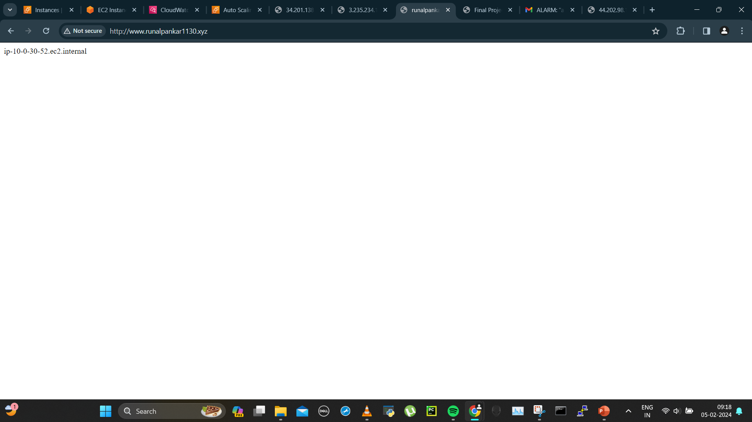
3rd instance

Slide 43

2nd instance

Slide 44
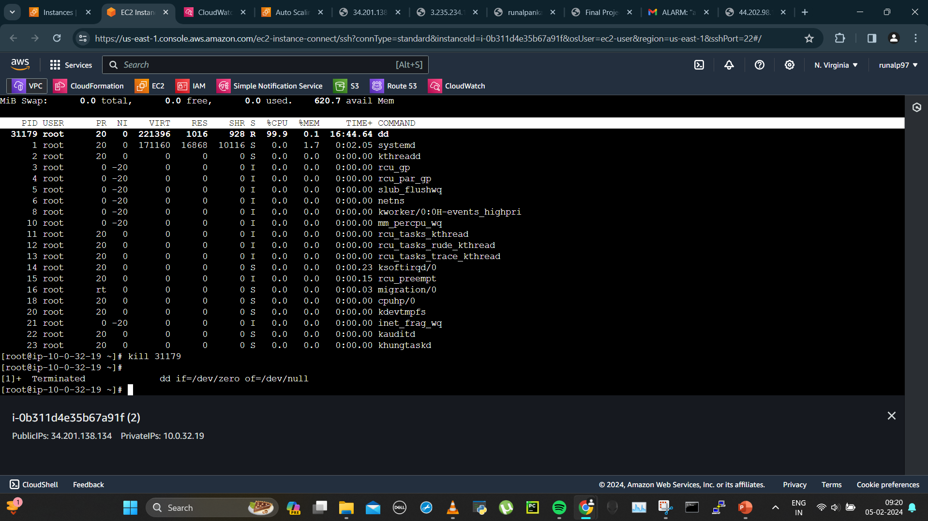
Dd command killed

Slide 45
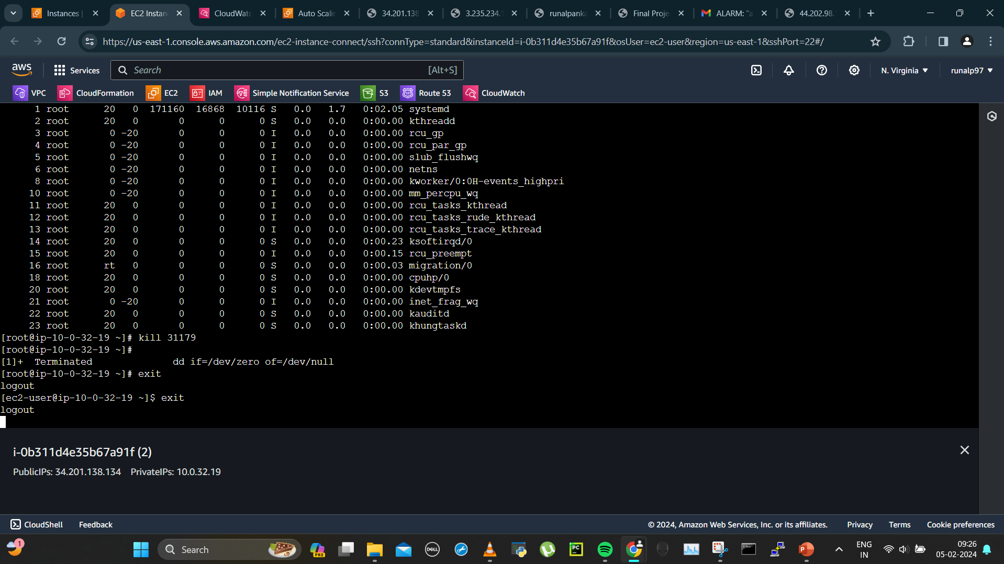
Exiting instance 2

Slide 46
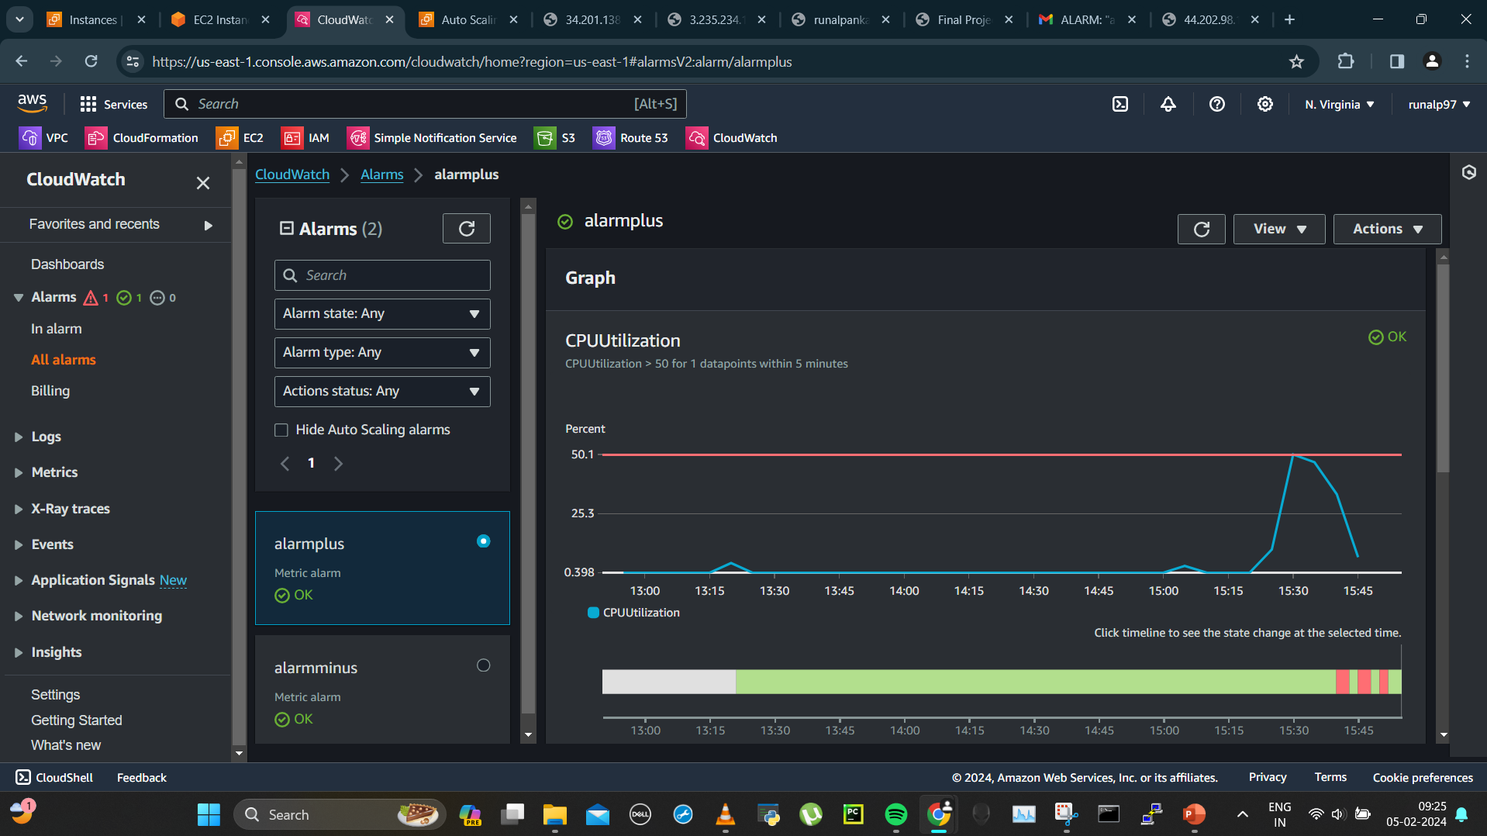
Cpu utilization going down

Slide 47
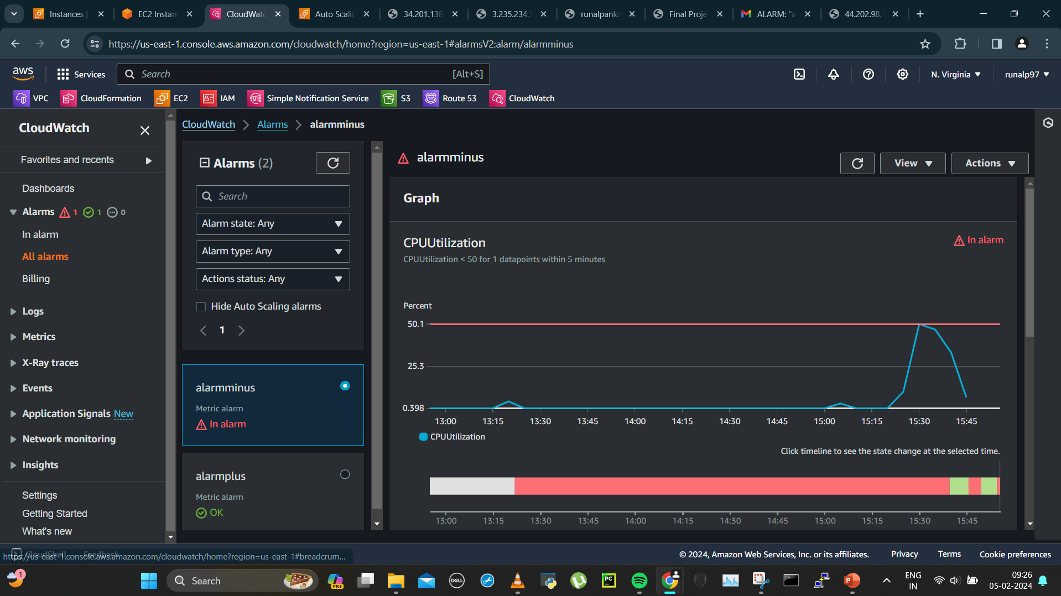
Alarm scale in “alarm minus” triggered

Slide 48
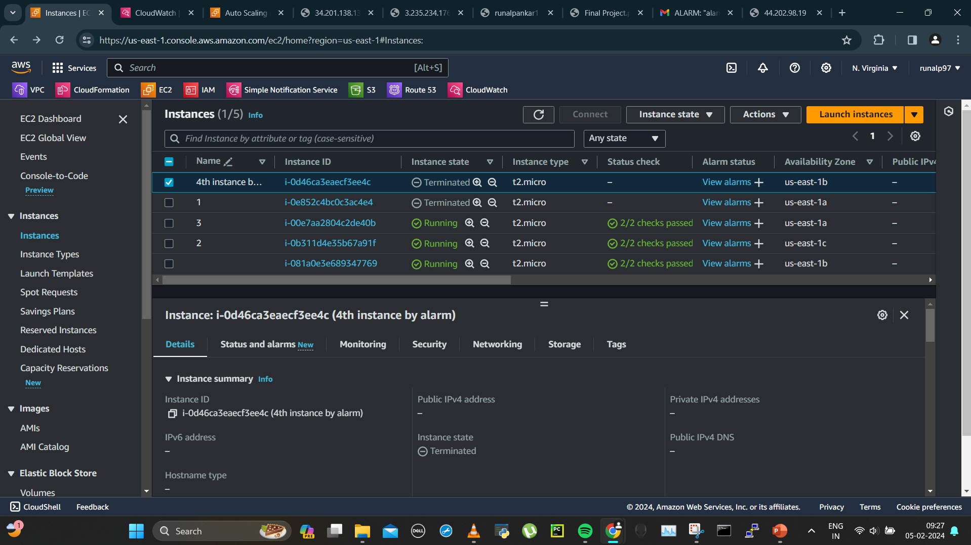
4th instance getting terminated

Slide 49
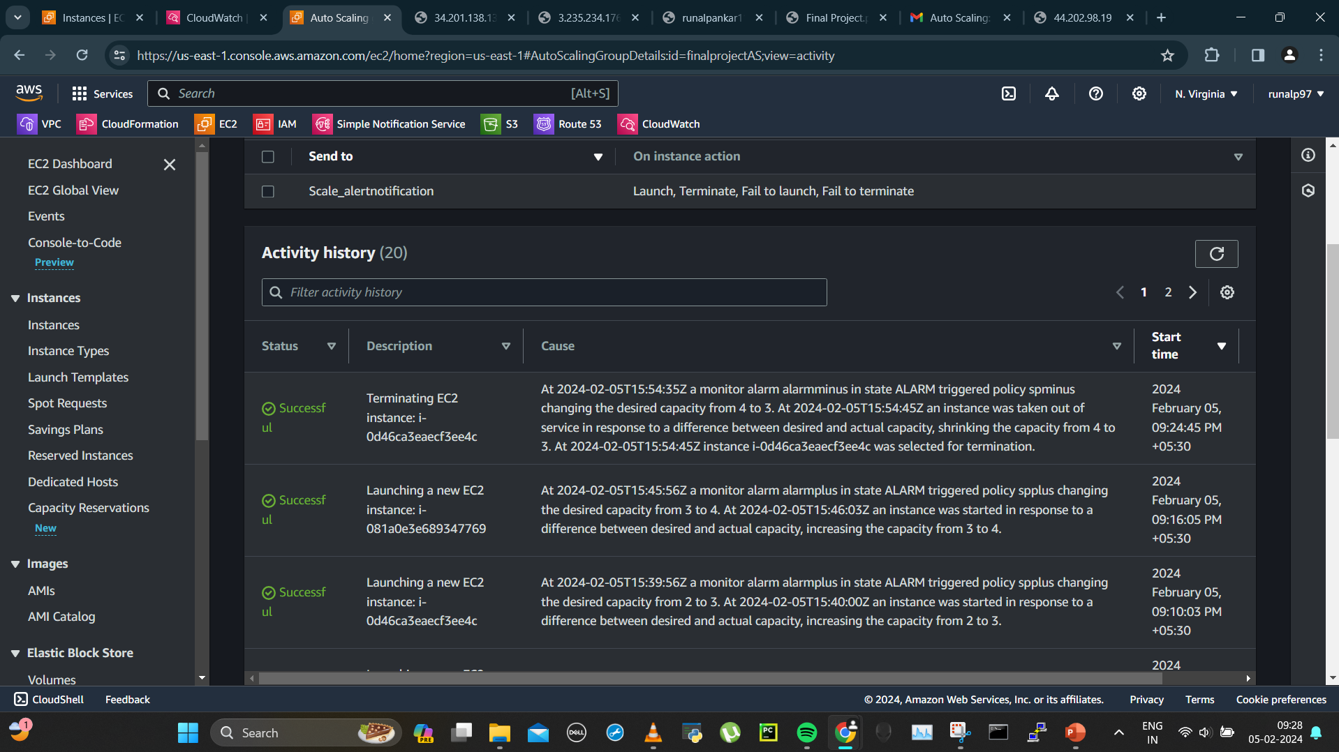
Asg history updated after alarm minus

Slide 50
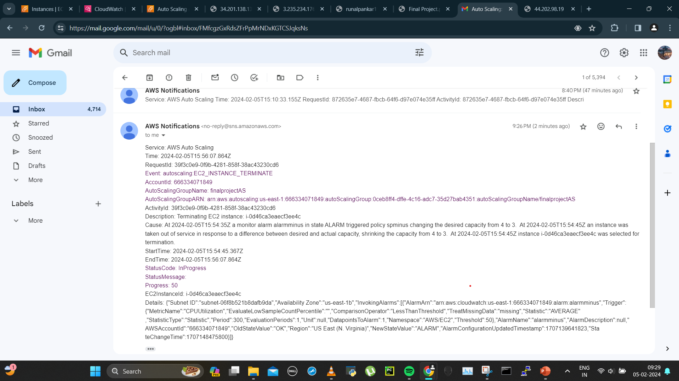
4th instance termination mail received

Slide 51
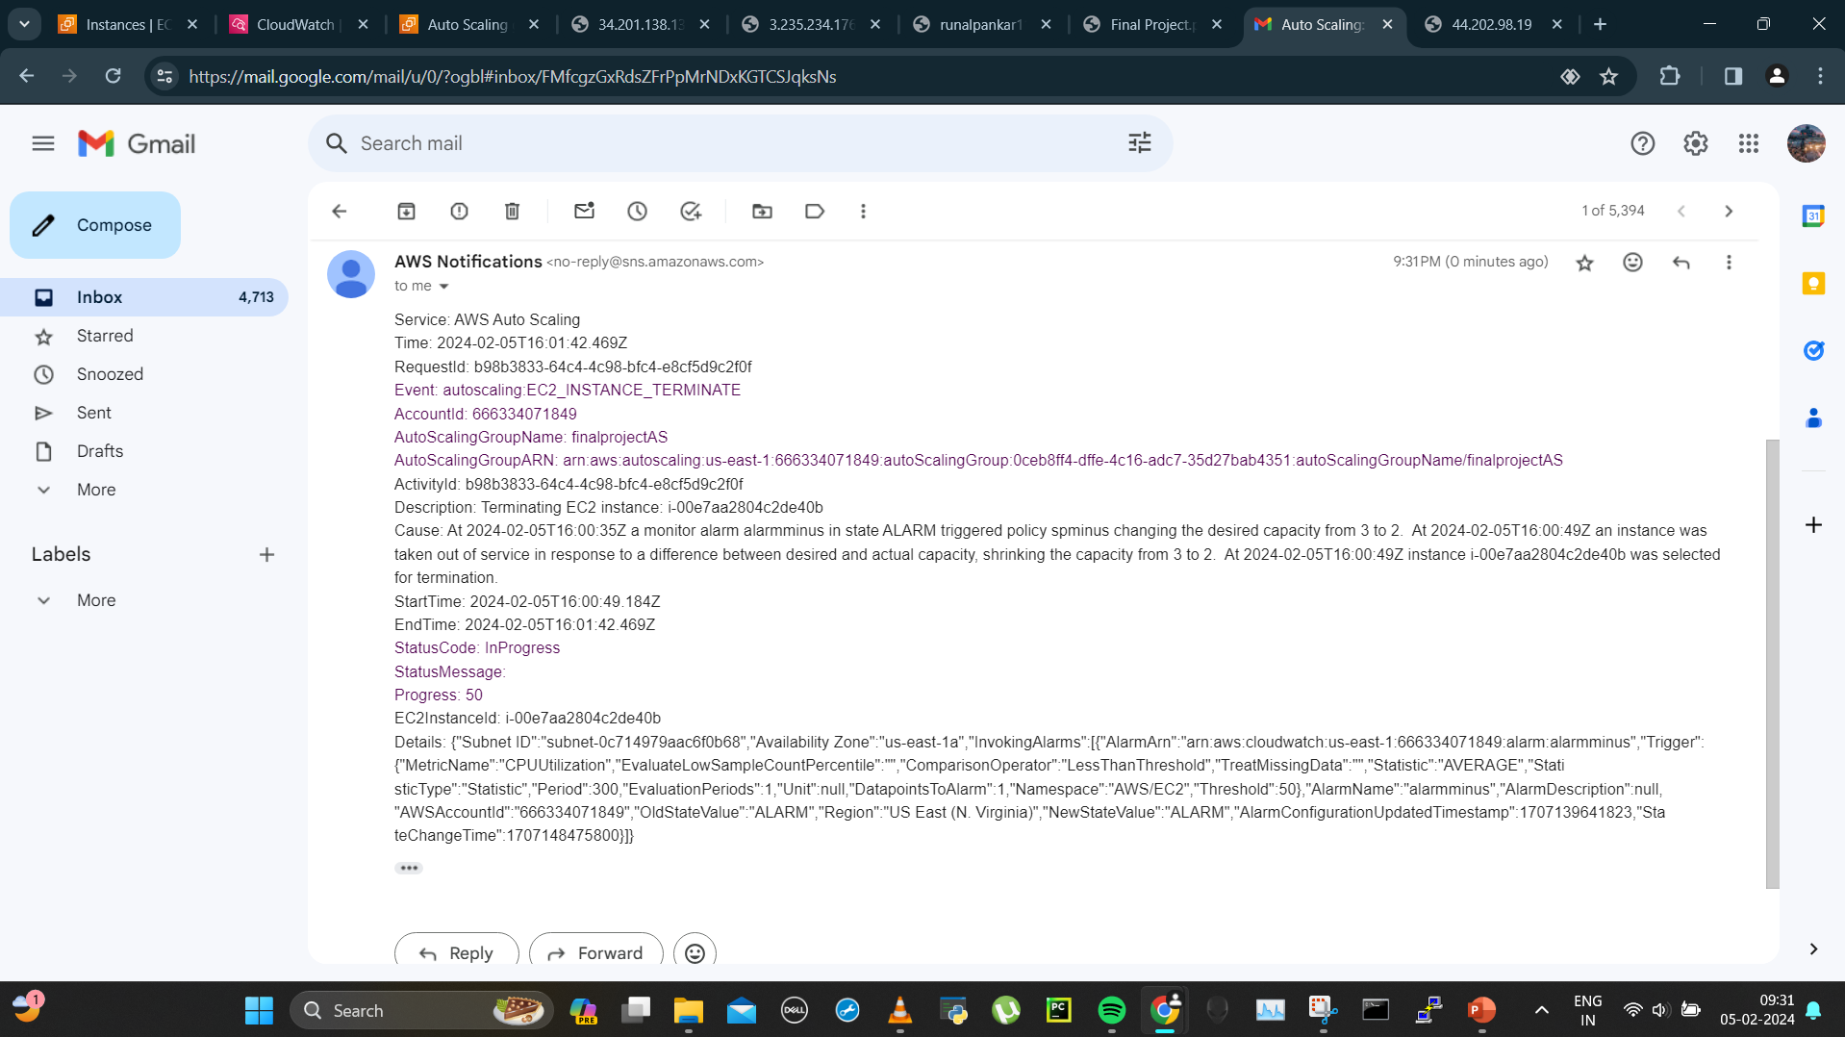
Instance 3 also got terminated, got mail and the asg is only keeping now the desired instance number that is 2

Slide 52
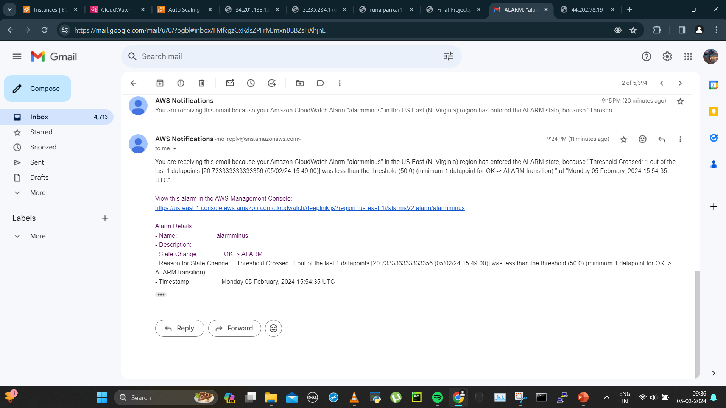
Alarm minus mail received

Slide 53
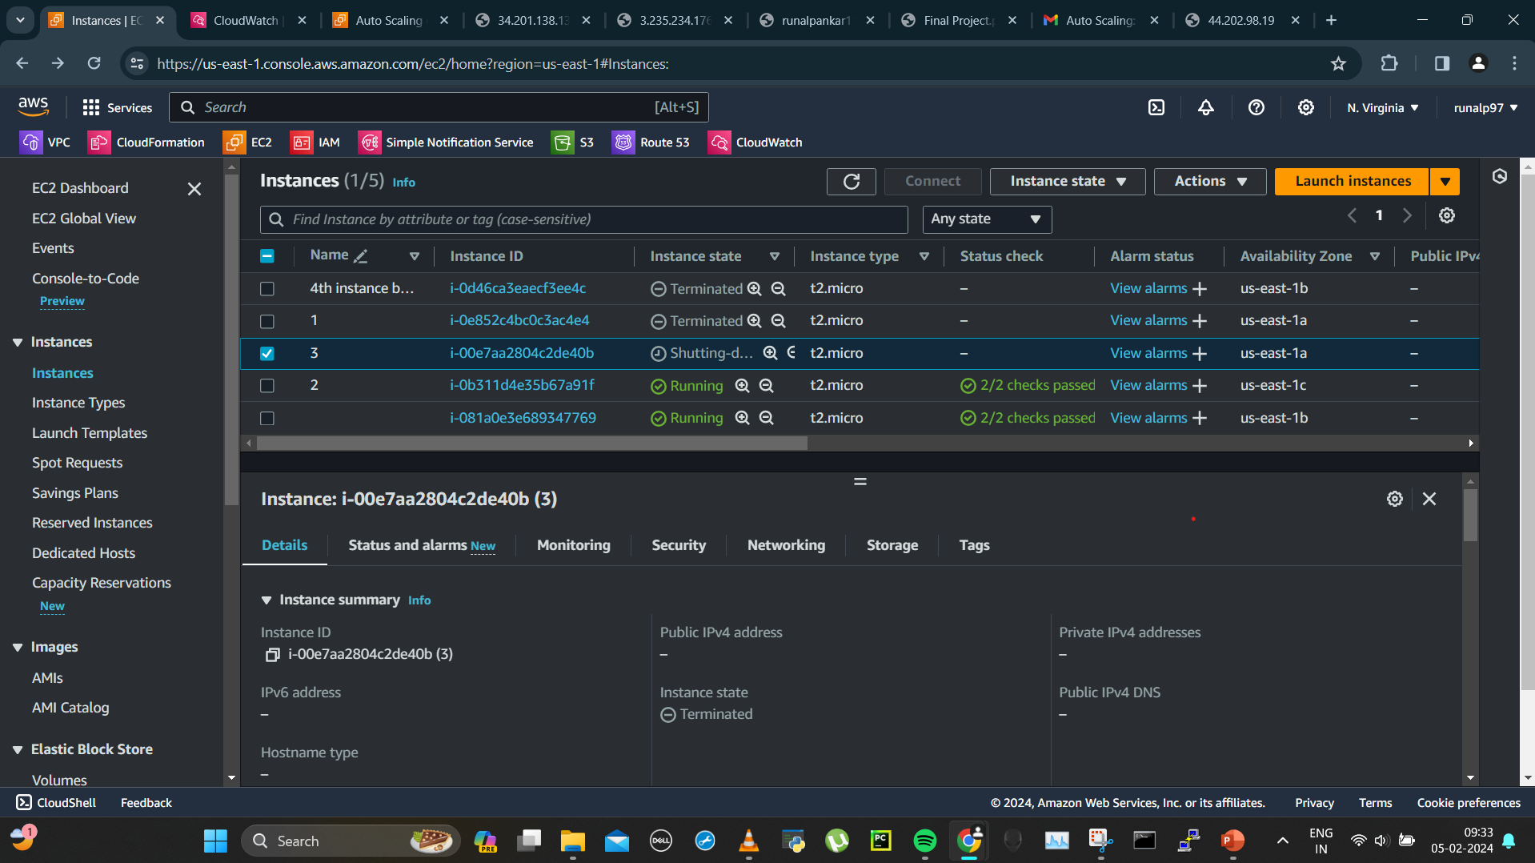
3rd instance terminated

Slide 54
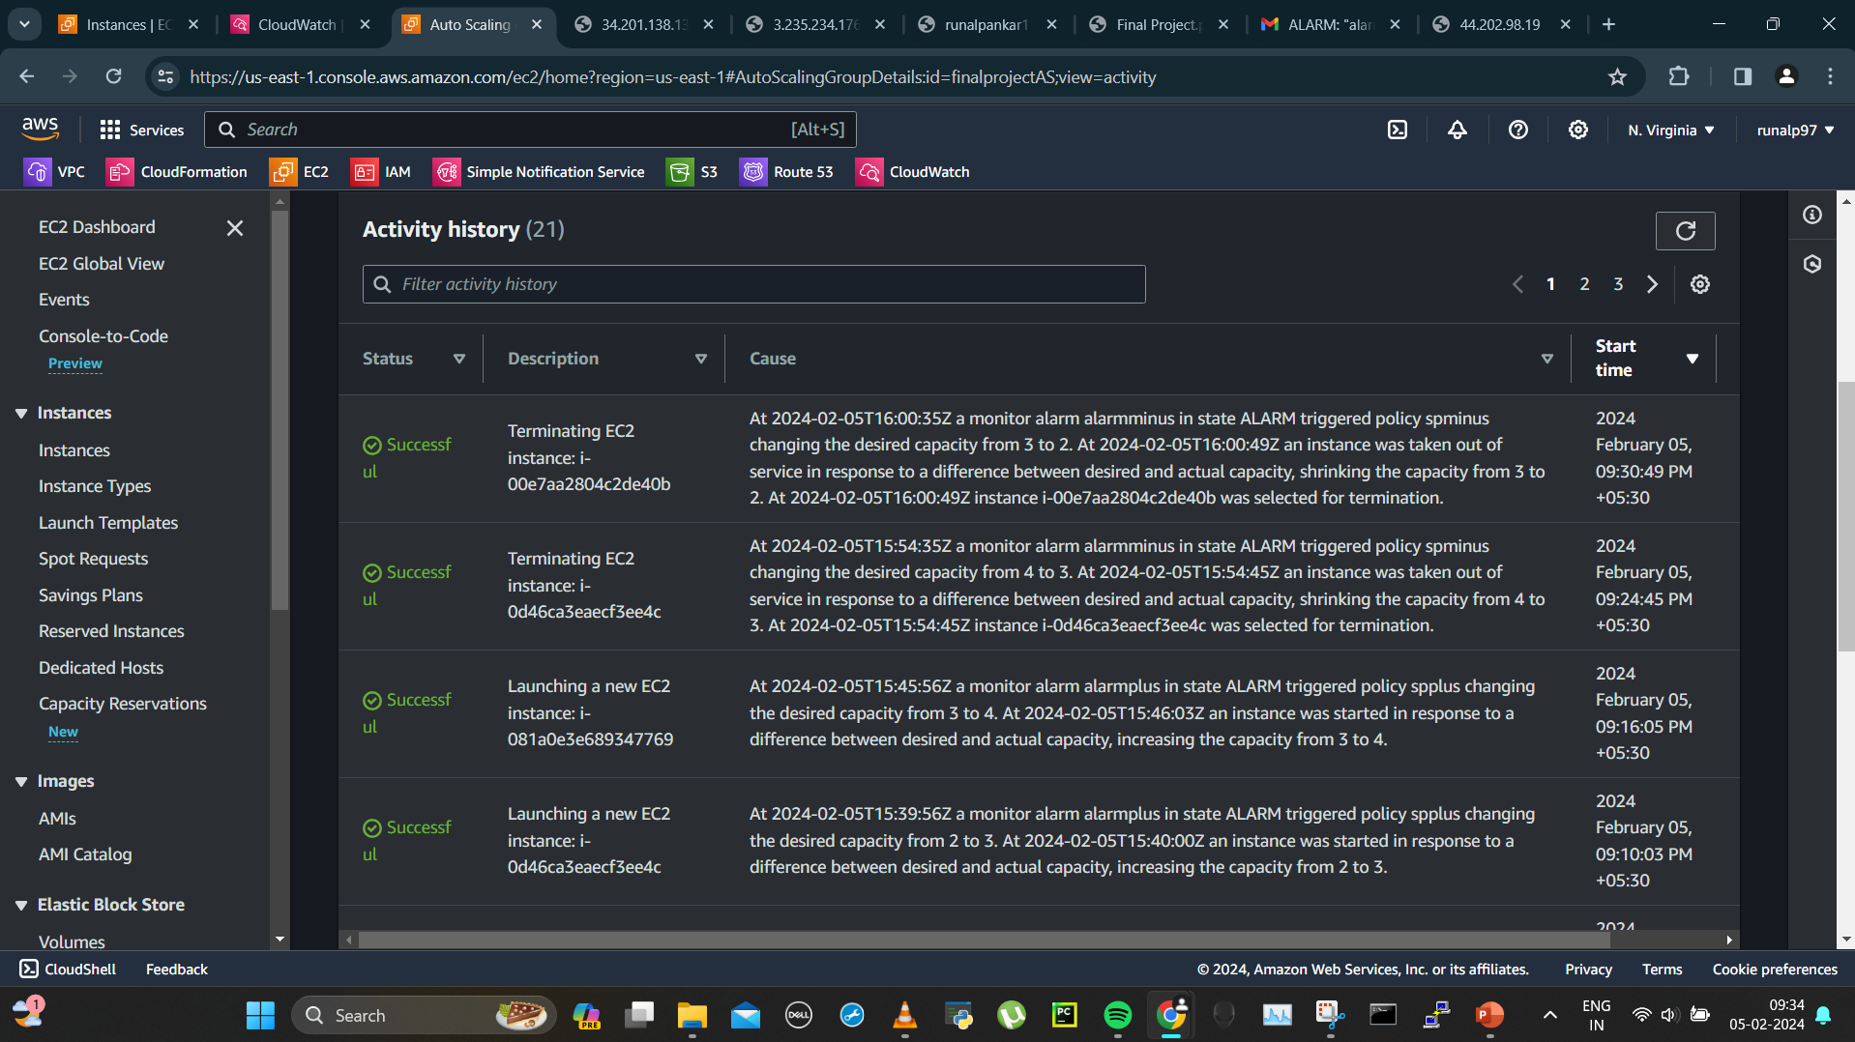
Asg terminated 2 instance as cpu utilization is decreased and have gone to desired minimum instance number

Slide 55

Final instance’s running

Slide 56

New instance ip

Slide 57

New instance public ip in web browser

Slide 58

Now my domain is showing the new instance ip and 2nd instance ip as the asg has kept only the desired minimum number of instances now

Slide 59

Instance 2 ip on my domain

Slide 60

Scale in alarm in alarm and scale out is now in OK state as there is no load on any instance for timebeing.

